Slide 1
Mathematical Modelling in Education
Kerri Spooner
Department of Mathematical Sciences
School of Engineering, Computer and Mathematical Sciences
Auckland University of Technology
Notes:
Teenaa koutou, Teenaa koutou, Teenaa koutou, katoa
Nga mihi nui kia a koutou katoa
Greetings to everyone here, warm greeting to you all

Slide 2
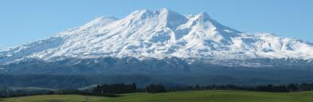
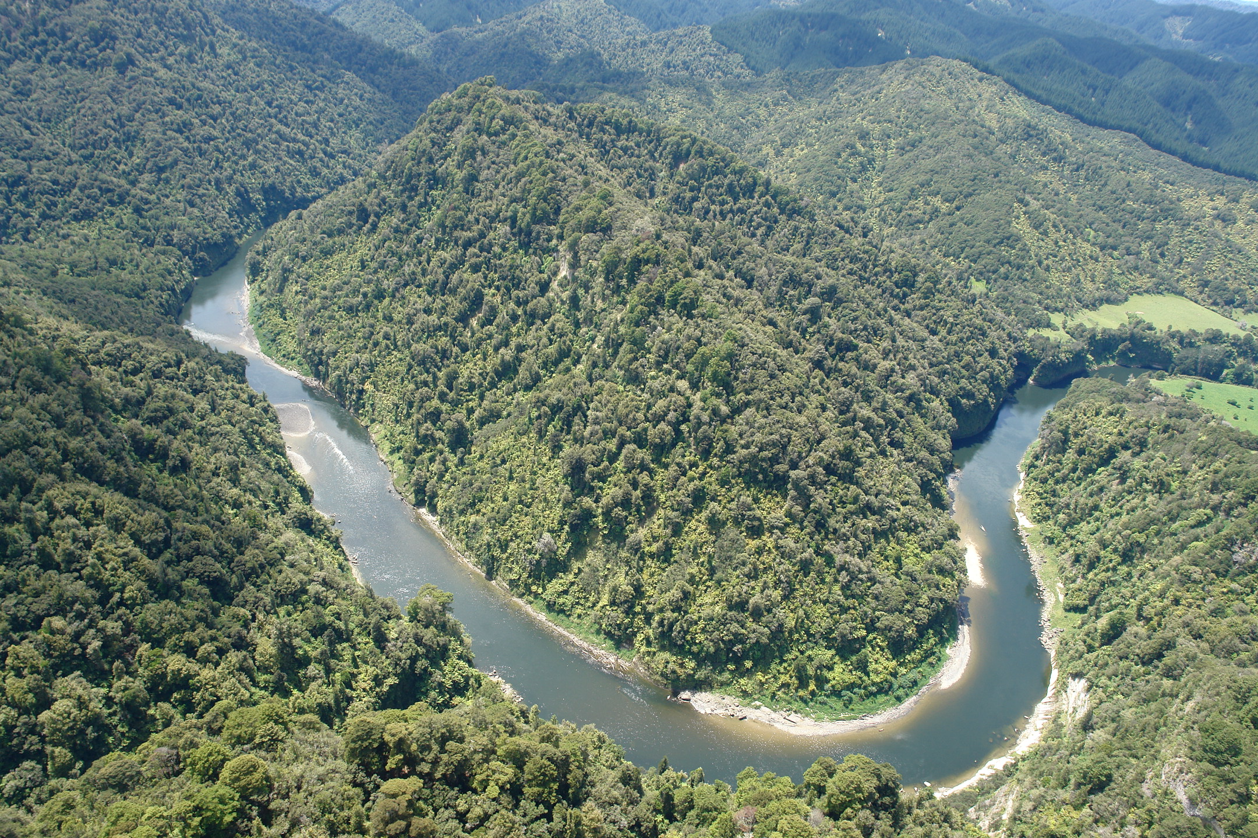
Pepeha
Ko Ruapehu tooku maunga
Ko Whanganui tooku awa

Slide 3
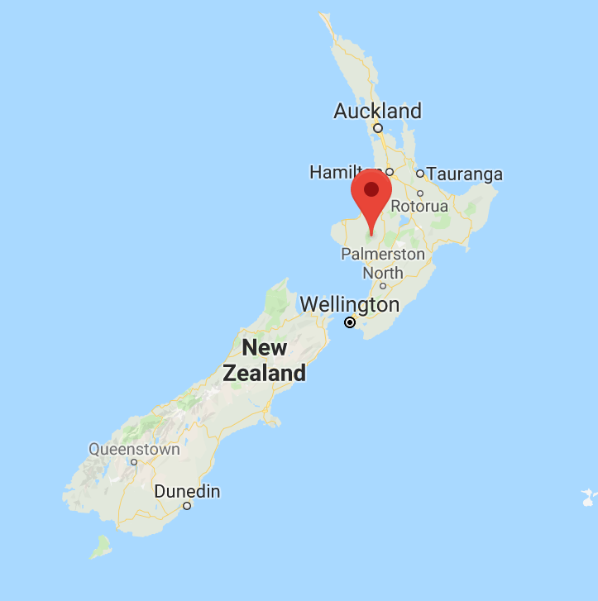
Ko Whanganui tooku rohe

Slide 4
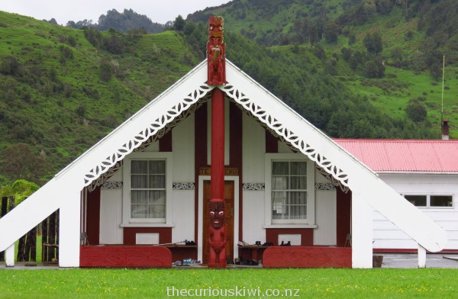
Ko Ngāti Ruaka tooku iwi
Ko Ranana tooku marae

Slide 5
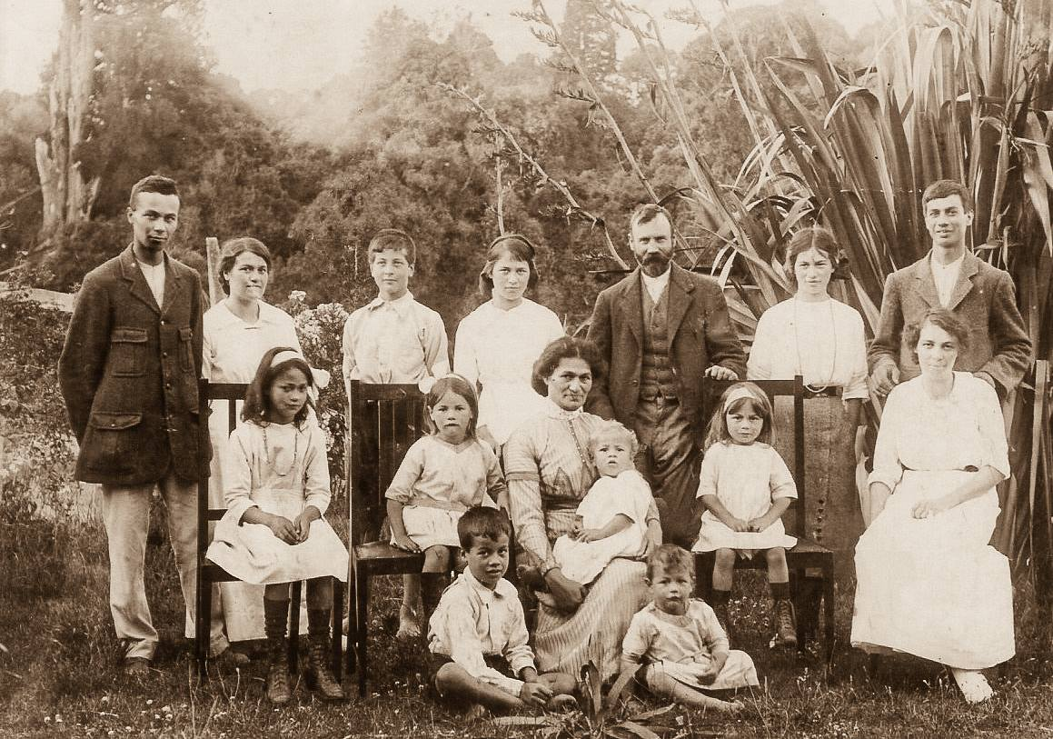
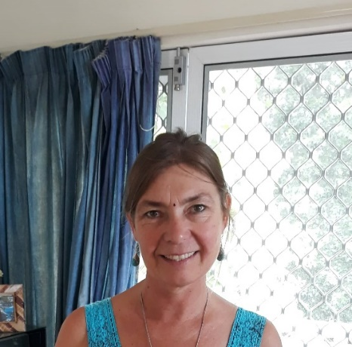
Ko Edward Spooner raua ko Mere Manson kaumata
Ko Kerri Spooner ahau

Slide 6

Kerri Spooner
Senior Lecturer
Mathematics Education
Research area -Teaching and learning of mathematical modelling
Teaching background
My passion – teaching STUDENTS my subject

Slide 7
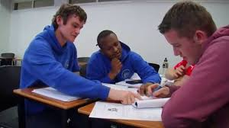
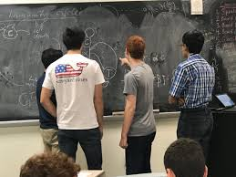
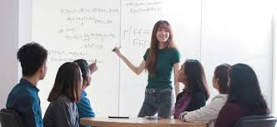
Masters PhD
Passion
Motivation

Slide 8


Why would we teach mathematical modelling?
How can we teach mathematical modelling?
Notes:
What is mathematical modelling?
Why teach modelling?
The state of art of modelling in New Zealand
What modelling is possible at secondary school?
Modelling at tertiary
Curriculum recommendations

Slide 9
Part one: What is mathematical modelling?
What might modelling be?
Working definition

Slide 10

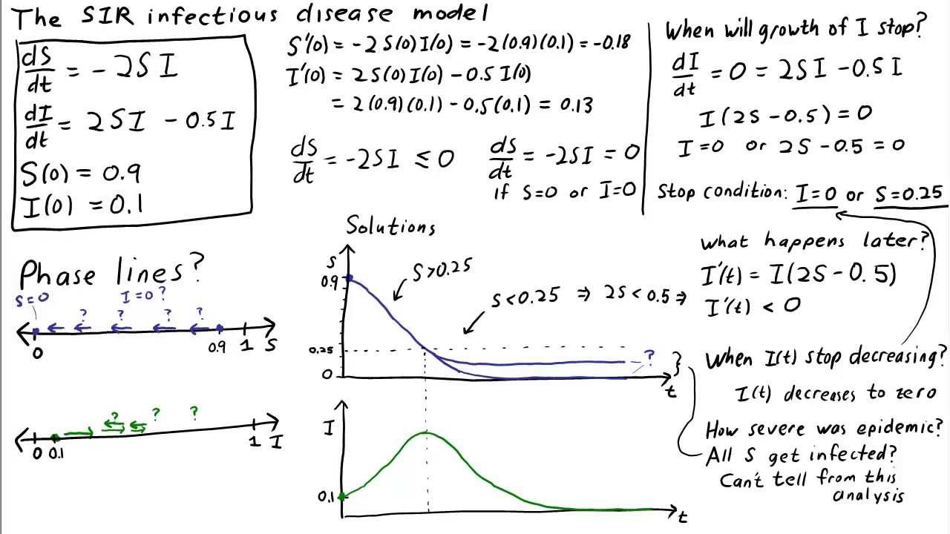
PROCESS
(based on work with Centre for Maths in Industry, Massey University 2011
and Dym, 2004; Svobodny, 1998; Treilibs et al, 1980)
Notes:
Mathematical modelling is:
the process by which we represent a situation in useful mathematical terms.
how we use mathematics to make sense of the world”. (Dym 2004; Wake 1997).”

Slide 11
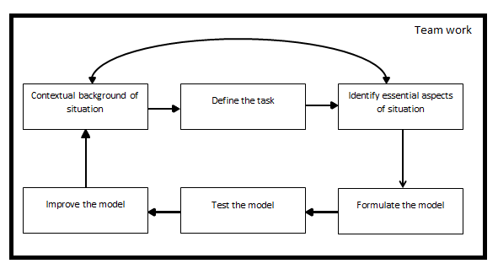
(based on work with Centre for Maths in Industry, Massey University 2011
and Dym, 2004; Svobodny, 1998; Treilibs et al, 1980)
Notes:
Simple example: Measure the thickness of a sheet of gladwrap using a ruler. Or DETERMINING THE THICKNESS OF ALUMINUM FOIL

Slide 12
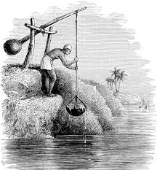
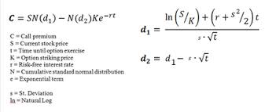
History
Archemides (c.287 BC – c.212 BC)
Black-Scholes model
Formalisation in education began around 1970s
Notes:
Black-Scholes model used to determine fair buying and selling prices on stock market

Slide 13
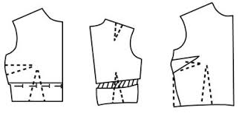
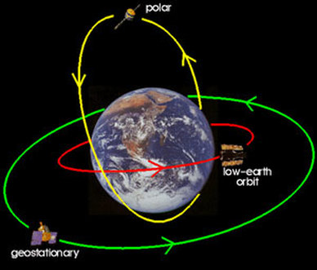
Part two: Why do we need modelling?
Outside of education mathematics is used within real world situations
Mathematics of school ≠ Mathematics of practice
Mathematically equipped citizens and effective members of working teams
No automatic transfer of pure mathematics
into usability in real world situations
Notes:
Outside of education is applied mathematics
Mathematics of school ≠ Mathematics of practice. The mathematics needed to keep a satellite orbiting around earth, model airflow over airplane bodies.
Most of the mathematics that is used outside of education is applied mathematics, that is mathematics that is used in conjunction with the real world.
For example:
Numerous studies conducted that show there is no automatic transfer from having learnt purely theoretical mathematics to be able to use it in situations that have not been fully mathematised (Niss et al 2007).

Slide 14
Part three: The state of the art of modelling in New Zealand
Curriculum
Classrooms
Competitions
Tertiary

Slide 15

“Students will model situations”
1992 Modelling included as a mathematical process.
Happening in classrooms?
Notes:
In the current 2007 New Zealand Curriculum it states students will model situations using mathematical knowledge for each level of the curriculum but does not give any specific examples or guidance as to how (Ministry of Education, 2007).
Up until 2007, the New Zealand mathematics curriculum mentioned modelling as a mathematical process, specifically promoting the use of mathematical models as a problem-solving strategy (Ministry of Education, 1992).
Caroline Yoon’s comment
My comment
Feedback for mathematics teachers consultation
What is happening with competitions

Slide 16
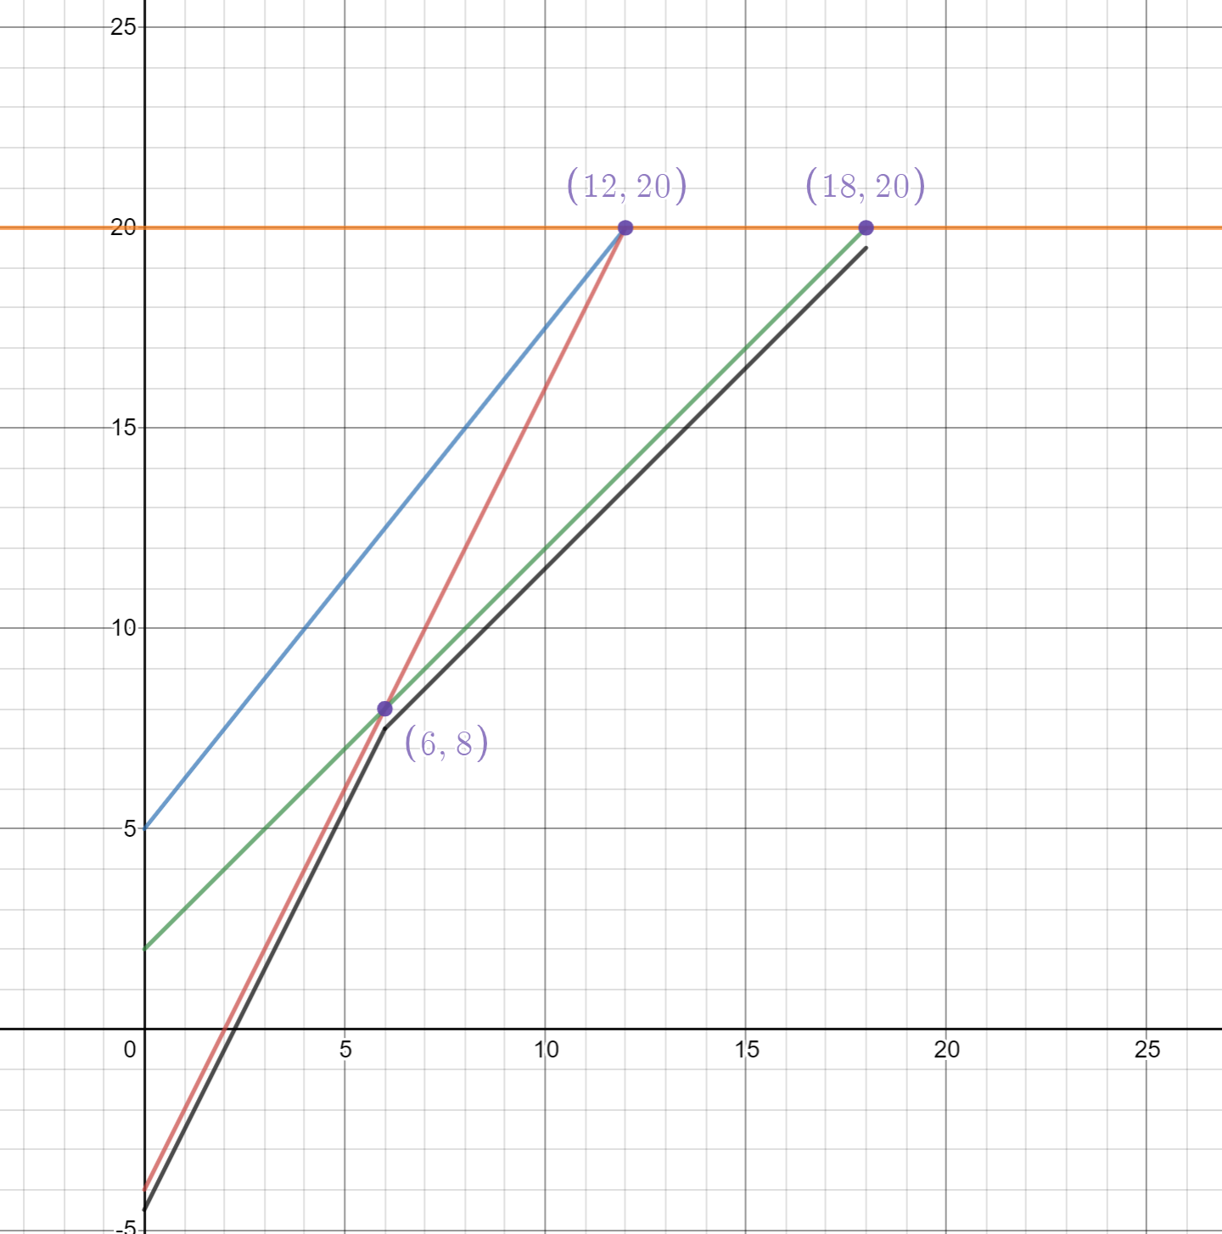
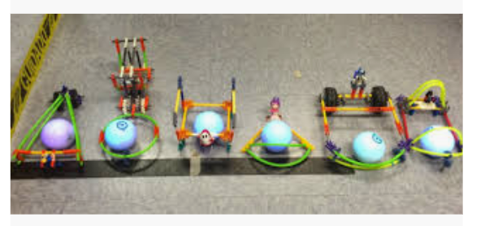
Subash Chandar K
Ormiston Senior College, Auckland
Notes:
Albany Senior High School
CS4HS computer science for high schools

Slide 17
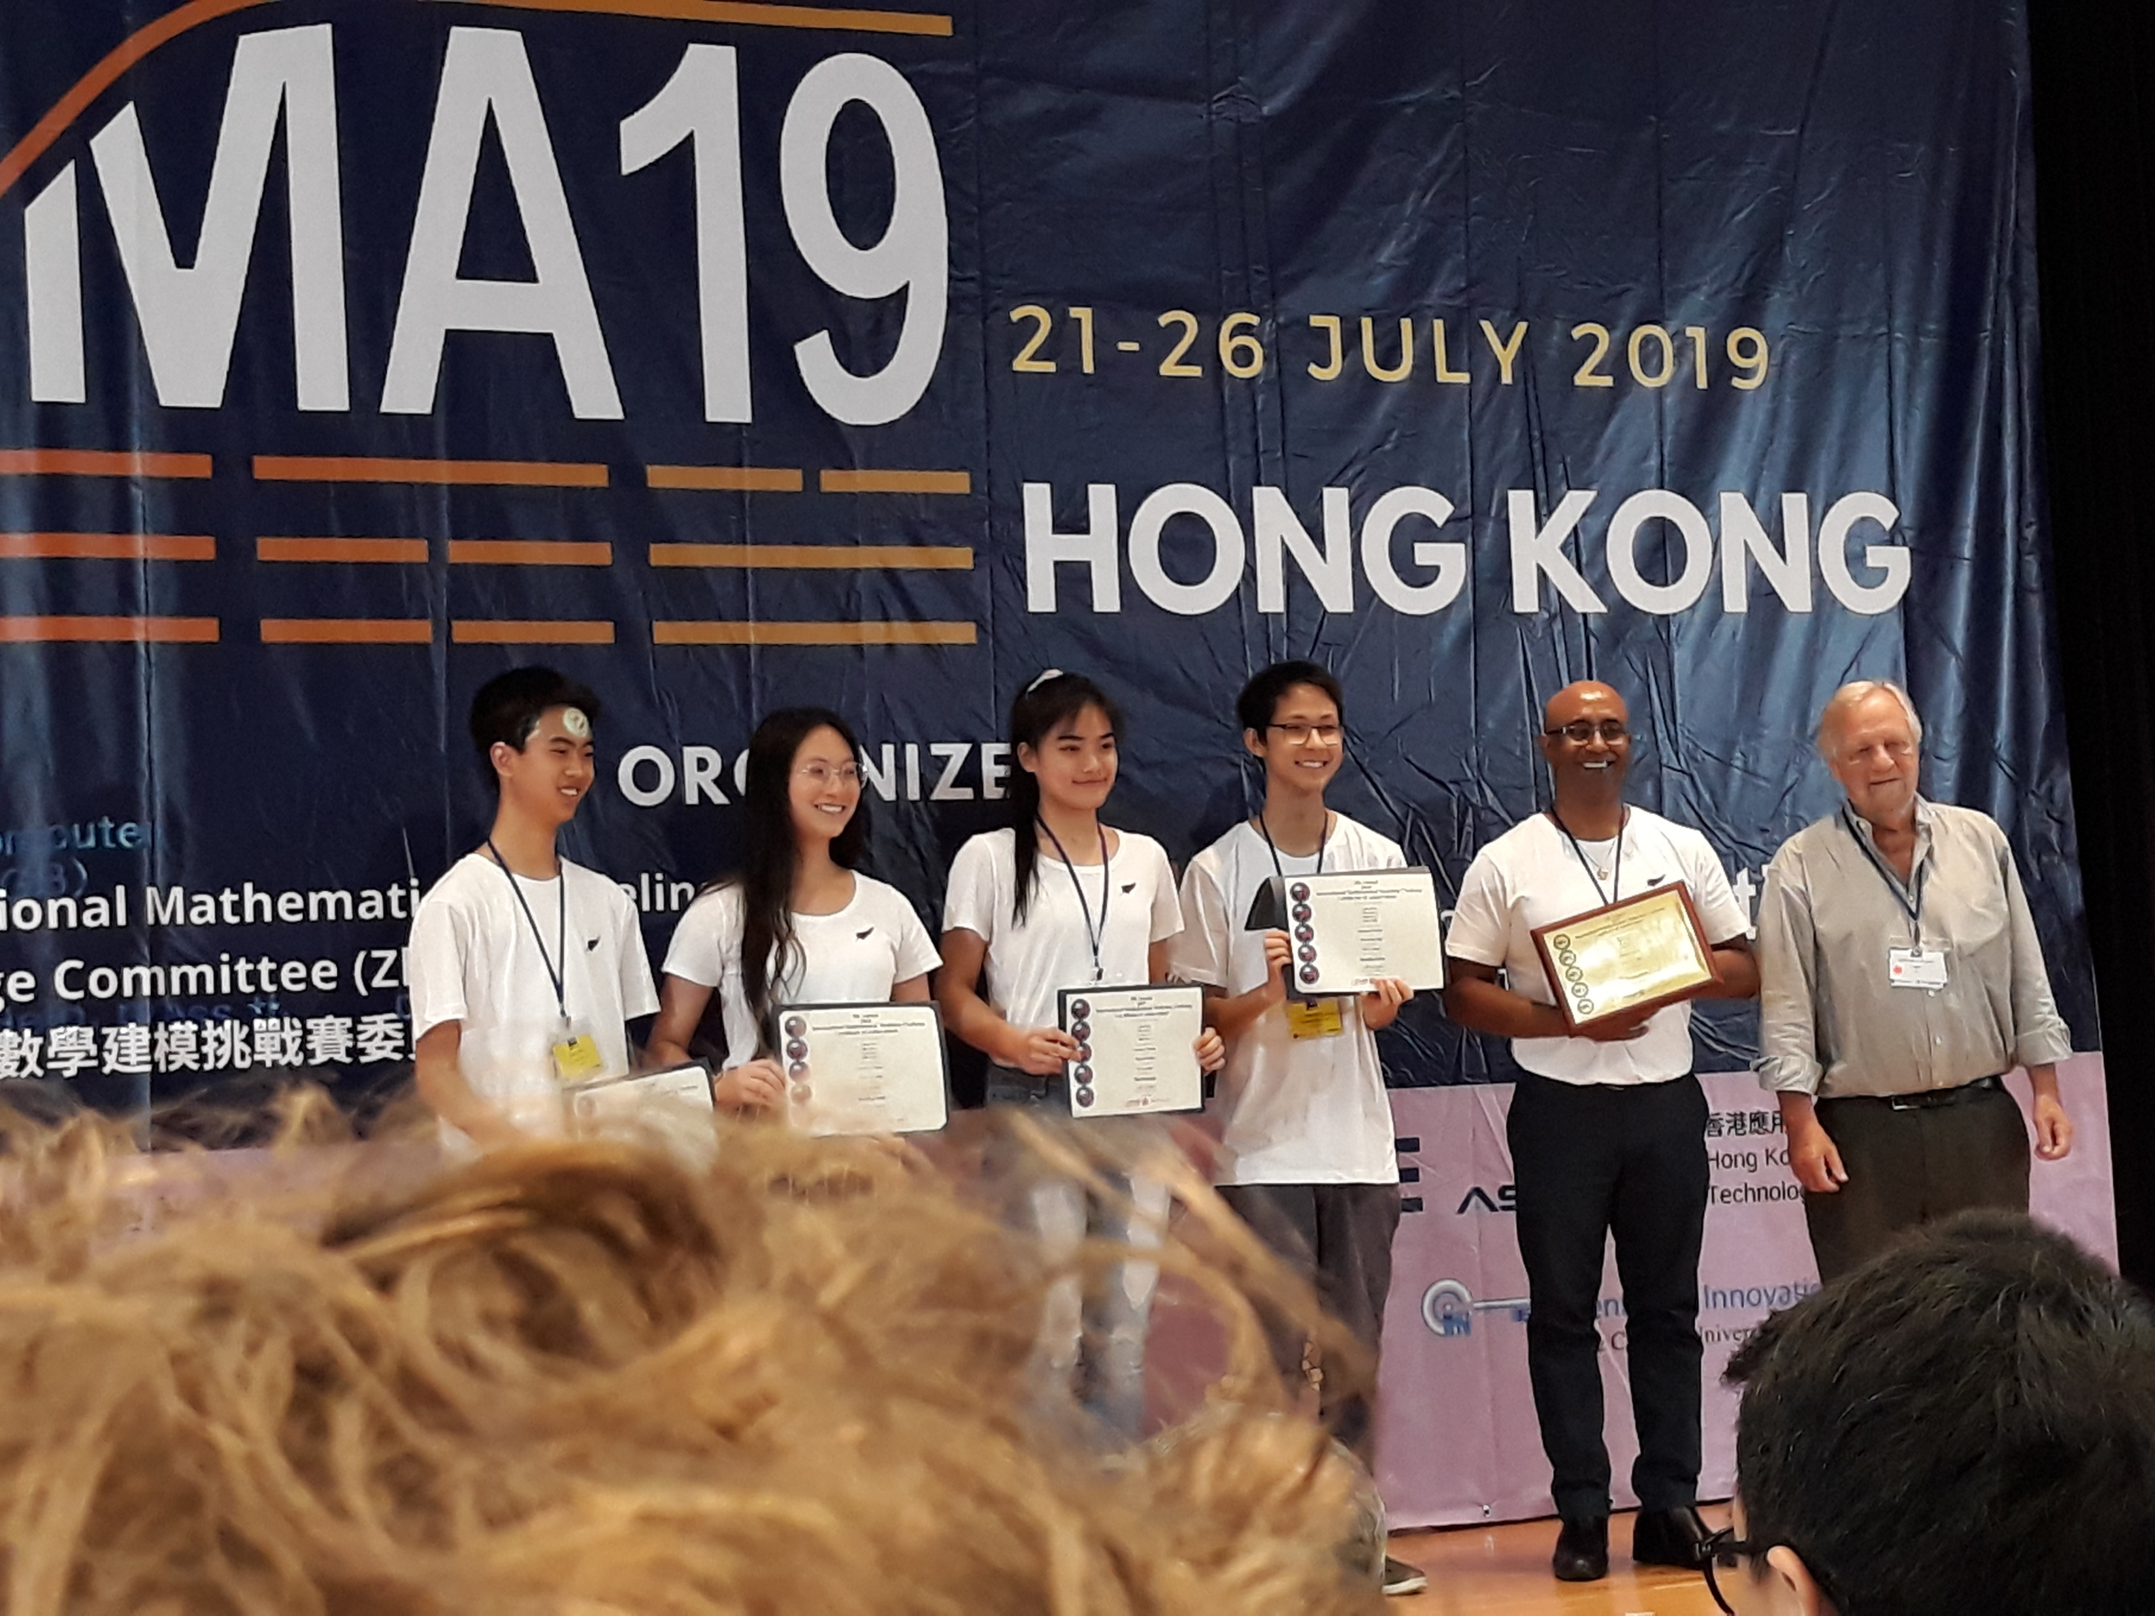
“New Zealand Engineering Science Competition”
https://www.auckland.ac.nz/en/engineering/about-the-faculty/engineering-science/new-zealand-engineering-science-competition.html
International Mathematical Modelling Competition(IMMC) https://www.tvnz.co.nz/shows/seven-sharp/clips/m anurewa-high-school-students-work-out-how-many-humans-can-fit-on-the-planet
Notes:
“New Zealand Engineering Science Competition”
https://www.auckland.ac.nz/en/engineering/about-the-faculty/engineering-science/new-zealand-engineering-science-competition.html
(Year 12 or 13 Maths or Science, get together with a team of 3-4 people from the same school. Occurs over one day)
IMMC Manurewa entry – factors are water, land, food. Used food to be limiting factor. Need to find efficient ethical solutions for food production that re have low resourcing demands

Slide 18
MINZ https://minz.org.nz/
Mathematics-in-Industry NZ (MINZ) events offer a collaborative approach to industry problem solving, where mathematical scientists tackle real life problems shared by companies

Slide 19
Part four: What modelling is possible at secondary school?
Holistic open ended modelling questions
Work being done in Germany
Work being done in USA
Recommendations from mathematical modellers

Slide 20
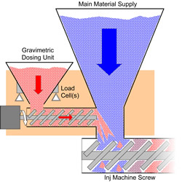
Holistic open ended modelling questions
Potential authentic modelling behaviours of a secondary-school student
Forming a Modelling Group
Establishing a shared understanding for the problem situation.
Defining the problem.
Recognise and identify the essential aspects of the situation.
Forming a model.
Testing the model
Improving the model
Reporting on the model.
Supported by Maab 2006
Notes:
Average year 12 students
Looked at behaviours of real world modelling team
Transposed these into what they could look like for a 16 or 17 year old school student
Here are the behaviours (headings only)
Using these as the base, students and myself worked through 3 activities
Supprted by Maab 2006

Slide 21




You drop your mobile phone will it break?
What is the best position to take a successful rugby kick?
How far out to sea would you see
a lighthouse?

Slide 22
Germany
Compulsory part of the curriculum
Notes:
Compulsory part of the curriculum and part of intermediate school graduation.
Mathematical modelling is one of the six general mathematics standards.
“Students are to acquire the ability to translate between reality and mathematics in both directions” (Greefrath & Vorholter 2016).
Modelling refers to entire process and is described as a competency.
How did this happen? Based on the results for the modelling mathematically competency defined in the Danish KOM (Competencies and Learning of Mathematics) project (Niss 2003) and results from international comparative studies (Greefrath & Vorholter 2016). The KOM project defined modelling mathematically as “analysing and building models” (Niss 2003, p 7) and was defined through consultation with a committee made up of mathematics teachers, mathematics education researchers, mathematicians and a small number of non-mathematics people.
Modelling competency is to be able to autonomsly and insightfully carry out the all aspects of the modelling process in a certain context.

Slide 23
In German classrooms
During documenta everything is more expensive in downtown Kassel. A Hercules T-shirt, for instance, as a Kassel
souvenir, costs 15.99 € downtown, whereas in the shopping mall dez which is not far away, the same T-shirt costs only 12.99 €. The second question is: Is it worthwhile to drive to dez in order to buy this T-shirt there?
MUED www.mued.de

Slide 24
Modelling weeks and 3 day events in Germany
Pricing for internet booking of flights
Chlorination of a swimming pool
Optimal distribution of bus stops.
Notes:
Students choose from a selection of problems then placed in group with similar interest to work through the process and develop a model.

Slide 25
USA
Common Core State Standards
Happening in classrooms
Supportive resources
Notes:
2010 CCSS modelling became a standard of mathematical practice – full page discussing and defining modelling. Simple examples such as writing total cost of bag of oranges as a product of unit price/orange and number bought to more complicated ones such as Estimating how much water and food is needed for emergency relief in a devastated city of 2 million people .
Stresses modelling is a process that involves choices. (And don’t always have complete information when solving real world problems)
Supportive resources have been developed by Society for Industrial and Applied Mathematics (SIAM) and NCTM curriculum advisers to help with this implementation (Hernández, Levy, Felton-Koestler, and Zbiek 2017).

Slide 26

Happening in classrooms
Petrol prices change on nearly a daily basis, and not every gas station offers the same price per litre of petrol. Today the gas station across town is selling the cheapest petrol. Is it worth the drive across town to buy petrol? Create a mathematical model that can be used to understand under what conditions it is worth the drive?

Slide 27
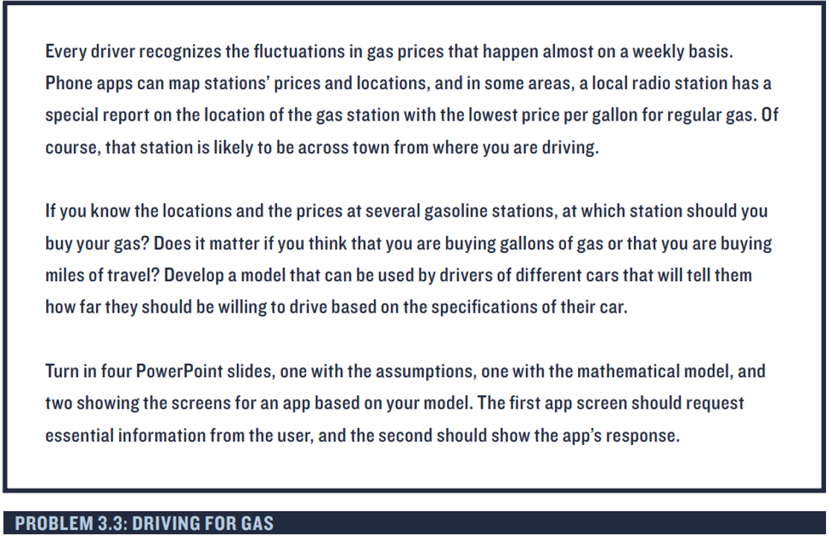
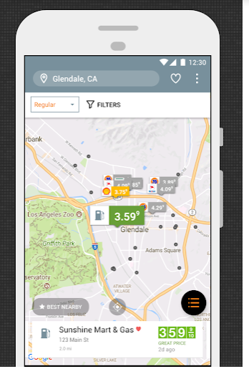

Slide 28
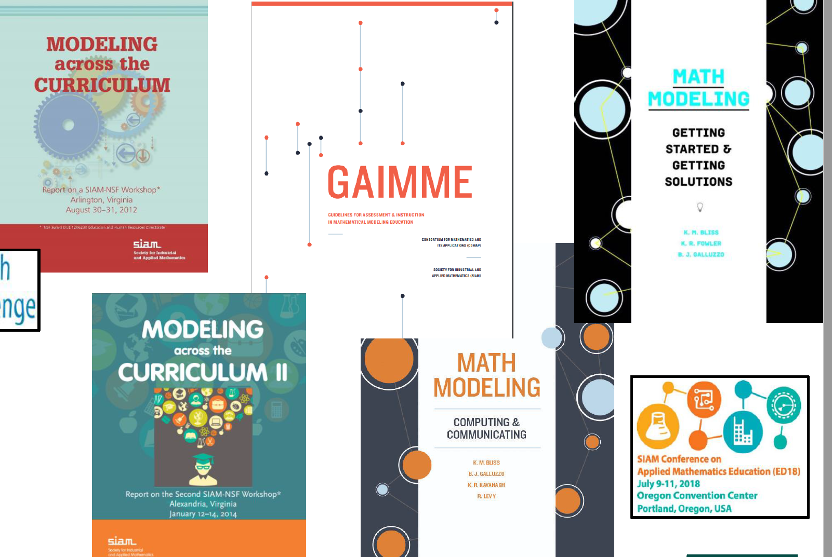
Supportive resources

Slide 29
Siam https://m3challenge.siam.org/resources/modeling-videos
Handbook with lots good breakdown tips
https://m3challenge.siam.org/sites/default/files/uploads/siam-guidebook-final-download.pdf
GAIMME report Guidelines for Assessment and Instruction in Mathematical Modeling Education
https://www.siam.org/publications/reports/detail/guidelines-for-assessment-and-instruction-in-mathematical-modeling-education
Modelling hub https://qubeshub.org/community/groups/mmhub

Slide 30
Modelling Competitions
M3challenge https://m3challenge.siam.org/
Consortium for Mathematics and Its Applications (COMAP)
https://www.comap.com/undergraduate/contests/
High school Mathematical contest in Modelling (Hi MCM)
https://www.comap.com/highschool/contests/himcm/index.html
Association of computational and mathematical modelling
Competition https://aocmm.org/competition Feb 2020
Notes:
https://aocmm.org/
Association of computational and mathematical modelling
Competition https://aocmm.org/competition Feb 2020
2018 problem “As one of the largest news and social networking website, Twitter is full of various news and information, real or fake. During the election, a fake news writer posts that Pope Francis supports Donald Trump. The news spread at an incredibly fast rate until 3 days later, a fact-checking website posts on Twitter saying that no proof shows that Pope Francis is related to Donald Trump. How long does it take to inform majority (90%) of Twitter users who have seen the fake news that it is actually a fake news?”

Slide 31

Where have you experienced mathematical modelling being successfully taught?

Slide 32
Recommendations from Mathematical Modellers
Apply mathematics to reality where ever you can
Exploration
Being wrong can be the first step to getting it right
Explaining and Interpretation of models
Communication
Making choices
Brainstorming
Being wrong can be the first step to getting it right
Start simple

Slide 33
Part eight: Curriculum recommendations
Clearly define modelling and provide supportive resourcing and professional development
Modelling as a process
Achievement standard focused on the modelling process
Move to broad open ended non-routine modelling problems
Modelling ‘days’ instead of lectures or classes
Factor in time into teaching for modelling

Slide 34
Conclusion to transit between secondary and tertiary

Slide 35
Part Five: Modelling at Tertiary
Modelling days for open ended questions
Case studies
Popular culture
Friday 15th November 130pm WT121 for more detail on tertiary modelling practices

Slide 36

Open ended modelling questions
Notes:
Focus on the modelling process with utilising maths already learnt or new maths applied as a by product.

Slide 37
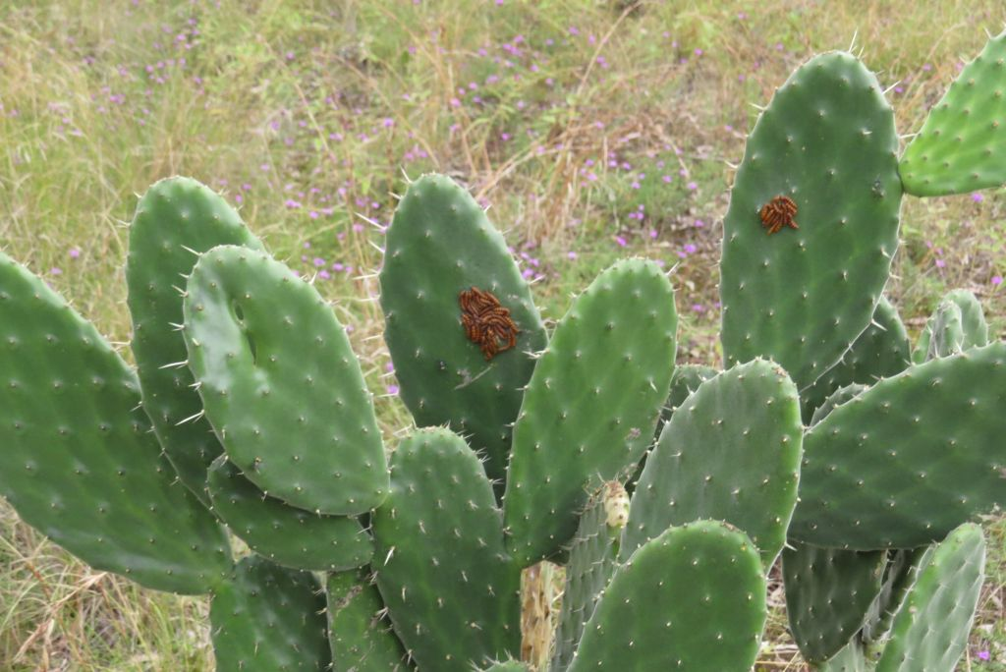
Case Studies
Prickly pear is controlled by Cactoblastis cactorum moth
Notes:
Focus first on the mathematics of the model and then on the process

Slide 38
Popular Culture
A radioactive leak at a nearby military base leads to dead bodies becoming reanimated as zombies. The zombies attack and kill humans, and can only be stopped by decapitation or by burning.

Slide 39
Where have you seen mathematical modelling being successfully taught?

Slide 40
Conclusion
Notes:
Strong conclusion

Slide 41
What are the possibilities for your teaching practice?
Notes:
Secondary – it is part of the curriculum
Tertiary – set seeds for being a mathematically equip citizen

Slide 42
Make table/ list
What things can we ignore?
What things can we assume to be constant?
Rank the factors in order of importance
Can we write what we want in terms of what we want to find out?
What do we know | What do we want to find out

Slide 43
What do we already know about a rugby field?
What do we already know about kicking?
What are we going to assume /ignore for a simple model
What factors are important?
What things affect the position a kick is taken from ?

