Slide 1
A guided tour through mathematical landscapes with people, their changes in recent decades and the job market for mathematicians in Germany
A subjective view
Günter Törner
University of Duisburg-Essen (Germany)
March 9th, 2026
www.uni-due.de
Notes:
We consider the thresholding scheme, a practically relevant time discretization for mean curvature flow (MCF) introduced by Bence-Merriman-Osher; and prove a (conditional) convergence result in the multi-phase case.
The proof is based on the interpretation of the thresholding scheme as a minimizing movement scheme, which means that the thresholding scheme preserves the structure of (multi-phase) mean curvature flow as a gradient flow w. r. t. the total interfacial energy (joint work with Sellim Esedoglu). We use ideas of De Giorgi to show that the limit satisfies Brakke's inequality, a way to encode MCF as a gradient flow. Indeed, his abstract notions of metric slope and of variational interpolation for minimizing movements, as formulated by Ambrosio-Gigli-Savare, are taylor-made for this limit.
This is joint work with
1

Slide 2
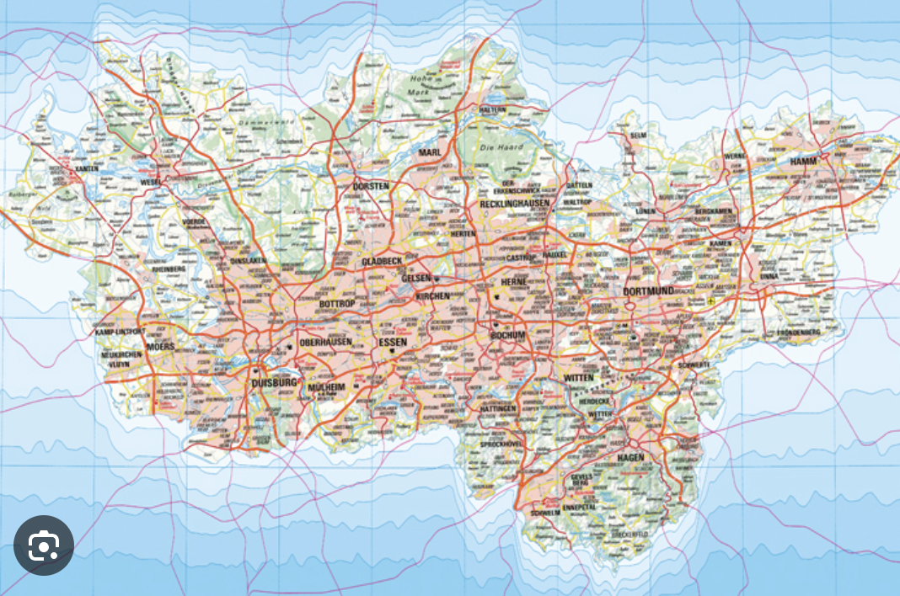
Ruhr-Region, the area that has been Günter's home since 1979
115 km East to West, 67 km North to South, 5,1 Million inhabitants,
Ruhr-Region 4.500 km²; NZ: 250.000 km²

Slide 3
Contents
  How mathematical landscapes have changed
  Why and how my personal orientation changed
3. Mathematics requires communication, working groups, discussion groups and small conferences in the regional neighbourhood
4. Mathematics needs friends and supporters who believe in mathematicians and put their faith in them
5. What consequences do these global international developments have for the job market for mathematicians in Germany? How can graduates prepared by university?
www.uni-due.de
Notes:
We consider the thresholding scheme, a practically relevant time discretization for mean curvature flow (MCF) introduced by Bence-Merriman-Osher; and prove a (conditional) convergence result in the multi-phase case.
The proof is based on the interpretation of the thresholding scheme as a minimizing movement scheme, which means that the thresholding scheme preserves the structure of (multi-phase) mean curvature flow as a gradient flow w. r. t. the total interfacial energy (joint work with Sellim Esedoglu). We use ideas of De Giorgi to show that the limit satisfies Brakke's inequality, a way to encode MCF as a gradient flow. Indeed, his abstract notions of metric slope and of variational interpolation for minimizing movements, as formulated by Ambrosio-Gigli-Savare, are taylor-made for this limit.
This is joint work with
3

Slide 4
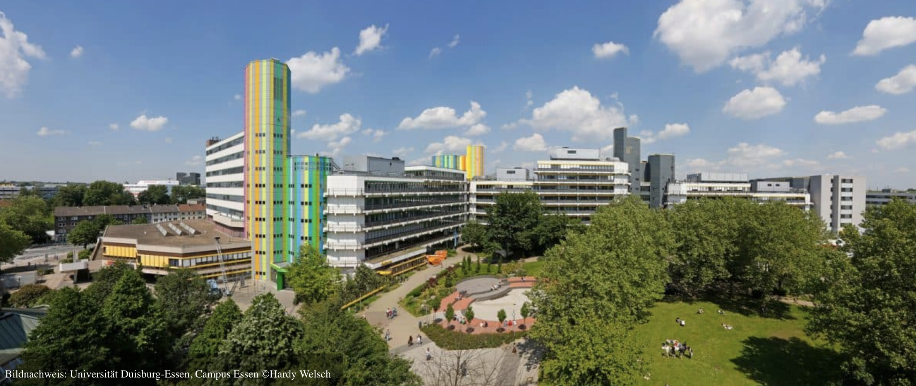
University of Duisburg-Essen – Campus Essen
The old university of Duisburg founded in 1655 (by Gerhard Mercator, cosmographer), closed 1818; reopened as an engineering school in 1891, 1968 turned into an university; merged together with the neighbouring university of Essen to University of Duisburg-Essen, 238 courses of study, 2 campus (Duisburg & Essen, distance 15 km), more than 40.000 students

Slide 5
Günter Törner (born 1947) - his subjectivity
    A research mathematician in the fields of noncommutative algebra, discrete mathematics and scheduling theory; today highly interested in mathematics for economy and industry
    Research in mathematics education for school relevant topics: Calculus, linear algebra, probability theory & statistics…
    Further (non-standard) areas of research: Problem solving and beliefs theory, Research in continuous professional development, initiating teachers‘ change, Adult education in mathematics..., The teaching of out-of-field mathematics teachers
    Many of my colleagues in the mathematics department know little about figures relating to mathematics; the same applies to the job market; ask Guenter...
    Looking back: Communication between mathematics educators and mathematicians – not an easy job; my advantage: I was always accepted as a mathematician...

Slide 6
How mathematical landscapes changed
The field of mathematics, with its results, is a time-independent constant, but where humans exert influence, there are always changes; that's life...
rankings for mathematical research fields,
the influence through the retirement process of professors, the name of working groups are changing.
editorial boards of journals and the determination of their publication areas,
society's expectations of mathematics,
influences of industry and business,
friends and research partner suddenly disappear and their important support is suddenly no longer available, everything in life is finite. Mathematicians should know to handle this term.
…

Slide 7
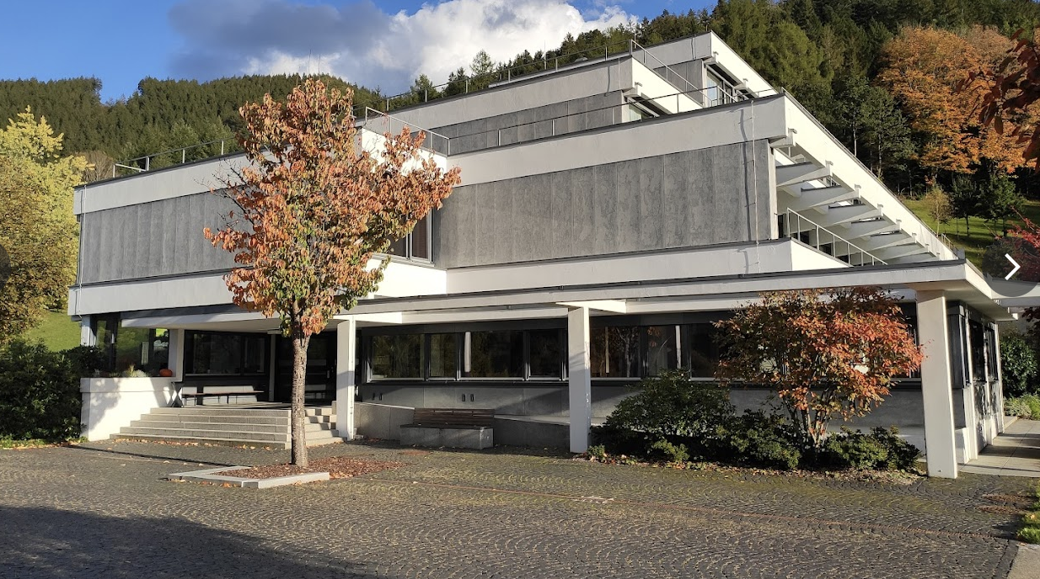
Situation in Germany anno 1980
Geometry was no longer in vogue in Germany.
The leading and prominent figures in this field (Sperner, Pickert, Bachmann, Salzmann…) had left the stage.
The regular conferences at the venerable Oberwolfach Centre became increasingly rare. The conference topics changed.
Thus, I became interested in noncommutative algebra – in particular, I could rely on scientifically strong partners

Slide 8
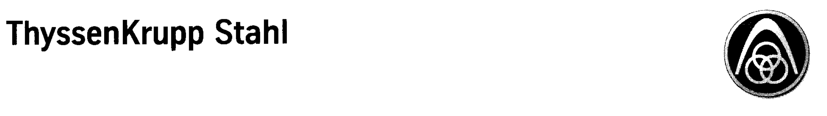
Why and how the orientations gradually changed
My university is/was located in a densely industrialised area, which was coal-mining area and the main place for producing high quality steel
The field of study Techno-Mathematics was to be developed: applied mathematics with elements of engineering. It was in the university's interest to establish partnerships with industrial companies.
With few exceptions, universities in Germany must increasingly see themselves as ‘open stores’ whose success is determined by their ‘customers’. These customers also have expectations of the respective educational and research institutions.

Slide 9
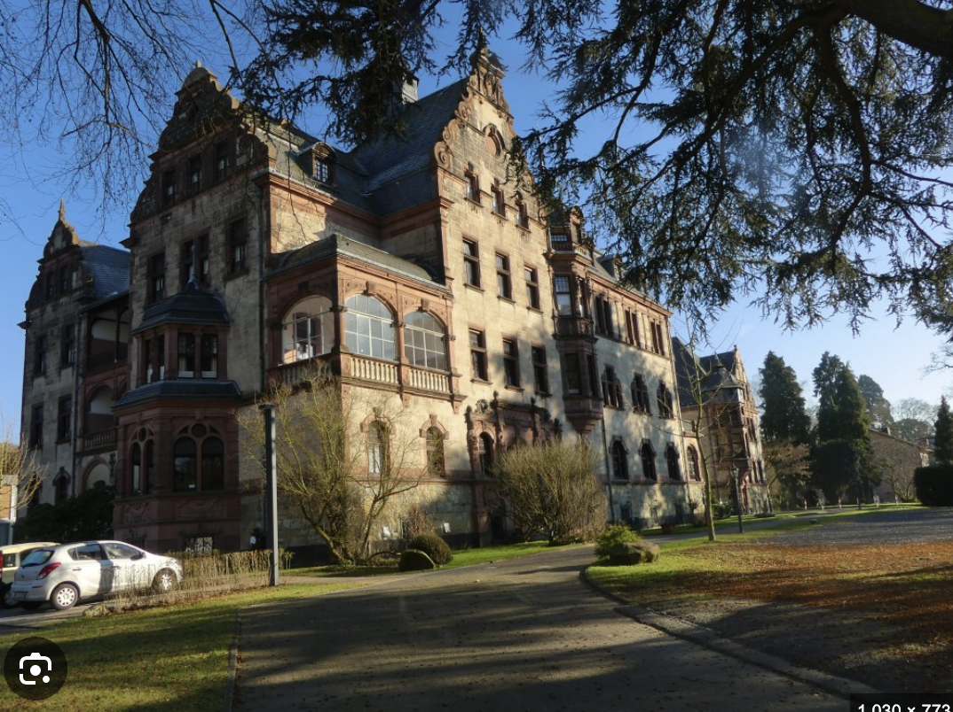
Our department in succeeding contributions
Mathematics requires communication, working groups, discussion groups and small conferences in the regional neighbourhood.
We were also able to launch a series of conferences (twice a year). We were also able to launch a series of conferences (twice a year).

Slide 10
The era of Prof. Dr. Martin Groetschel (Berlin)
Martin Groetschel, working in optimization theory, an inspiring person ‘took over’
He was elected as president of German Mathematical Society (DMV). This person also took care of reforming the organization of our professional association.
The DMV succeeded in bringing the ICM to Berlin in 1998. It was a tacit agreement that an exhibition on the persecution of Jewish mathematicians in German between 1933 and 1945 would be established.
He stipulated that in future, one seat on the DMV board would be filled by a person representing the field of mathematics education. After the first year, I was entrusted with this task for 10 years.
The International Congress for Mathematics (ICM) was held at Berlin in 1998
With the support of political friends, it was possible to bring the international office of the International Mathematical Union (IMU) to Berlin on a permanent basis.
What we have learnt: Mathematicians should have visions, it needs friends and supporters who believe in mathematicians and put their faith in them.

Slide 11
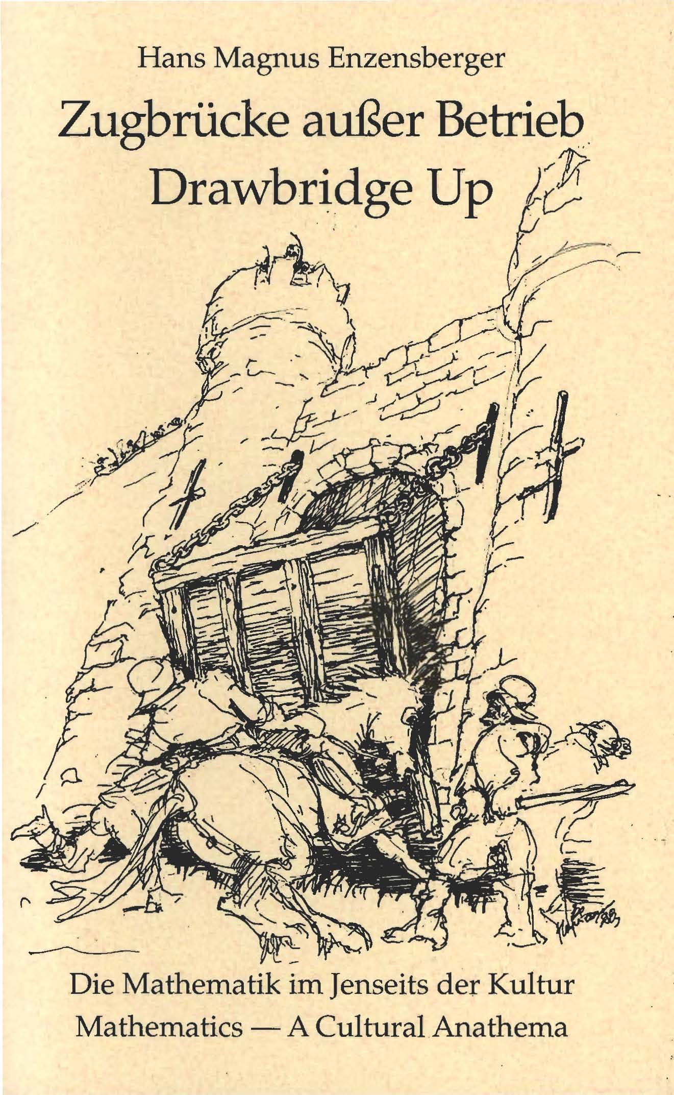
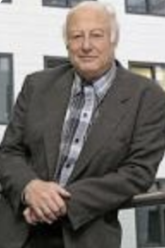
Establishing a mathematical research Fraunhofer institute partly financed by government money
The successful battle against mathematics in the ivory tower -- against Drawbridge up
Fraunhofer is an important funding organization for industrial projects, partly subsidized by the state. Its focus is on engineering sciences. The mathematician Helmut Neunzert (born 1936) made it his life's goal to establish a Fraunhofer Institute (1985).
Initially, there was considerable resistance, but politicians supported his visionary. There were blockades: Mathematics was too abstract and did not fit in with Fraunhofer. Ten years later, with political support, he achieved his goal. The ITWM Institute for Industrial Mathematics (ITWM) was founded in 1995. Today, this institute employs more than 500 scientists.

Slide 12

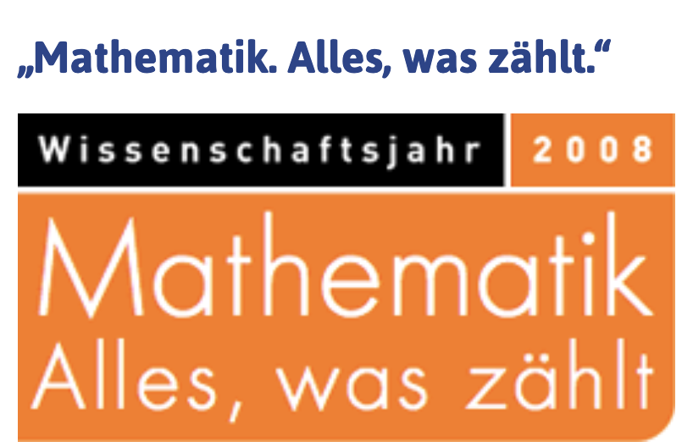
Magnus-Enzensberger: The Number Devil
At the end of the 1990s, one of Germany's most important contemporary writers, Hans Magnus Enzensberger, was persuaded to write an illustrated book entitled
The Number Devil – A mathematical adventure a bedside book for anyone who is afraid of mathematics.
Finally, our community also succeeded in establishing the Year of Mathematics 2008, a very successful year that brought friends to mathematics and new students.

Slide 13
Projects run by Martin Groetschel
But research topics of interest to the general public were not neglected either. Here are some of the topics that Martin Grötschel and his team worked on in the 1990s.
How many buses does Berlin's local transport system need? What is the minimum number? How can the permissible working hours be incorporated in such a way that the trade unions accept the solutions?
There are a total of around 201 bus routes in Berlin. These include 163 routes that operate during the day, as well as various express bus (X) and MetroBus routes that operate around the clock. The network covers over 1,800 kilometres and serves 6,770 stops, operated by BVG.
In West Berlin, there was a taxi service for disabled people that had to be controlled. Suddenly, the Wall came down and West Berlin became Greater Berlin. How do we now have to organize the regulations so that both halves of the city are optimally served?

Slide 14
5. What consequences do these global developments have for the job market for mathematicians in Germany?
First of all, I don't know whether these developments also apply to the job market in New Zealand, so just listen to what I have to say.
During my studies at university 60 years ago, I was never taught about the job market. People (including myself) believed that mathematicians in particular would find employment in insurance or banking; if necessary, they could probably find a job in a school. I actually embarked on my studies blindly.
It was also assumed that the professor who supervised a successful dissertation would always have good contacts in business and industry, would call a friend there and recommend his new graduate for a job. This industry figure would invite the job seeker for an interview and there would be a good chance of getting the job.
Even if this was the case – which I doubt – such an approach is no longer possible today. When companies need mathematicians, the positions are advertised; small committees are formed and it is the psychologists – not the mathematicians – who decide whether the potential candidate could be imagined as a future employee in the company, whether he or she would fit into the company.

Slide 15
Publications about the job market
Over the past twenty years, I have written four papers on the job market.
Information about the job market for mathematicians: Lots of light, but also some shadows. Notices of DMV 31 (2023), 2, 84–93.
Job market for mathematicians. Notices of DMV 27 (2019), 2, 26–31
The job market for mathematicians -- Part 1: Notices DMV 22 (2014), 154--157.
Figures relating to mathematics studies -- Part 6: The job market for mathematicians. Notices DMV 17 (2009) 4, 247--252.
Mathematicians generally have good career prospects. Twenty years ago, people said that mathematics was a subject with a job guarantee, but now there are a few caveats to mention. After all, the economic situation in Germany also affects the job market for mathematicians, so it inevitably takes longer to find a position.

Slide 16
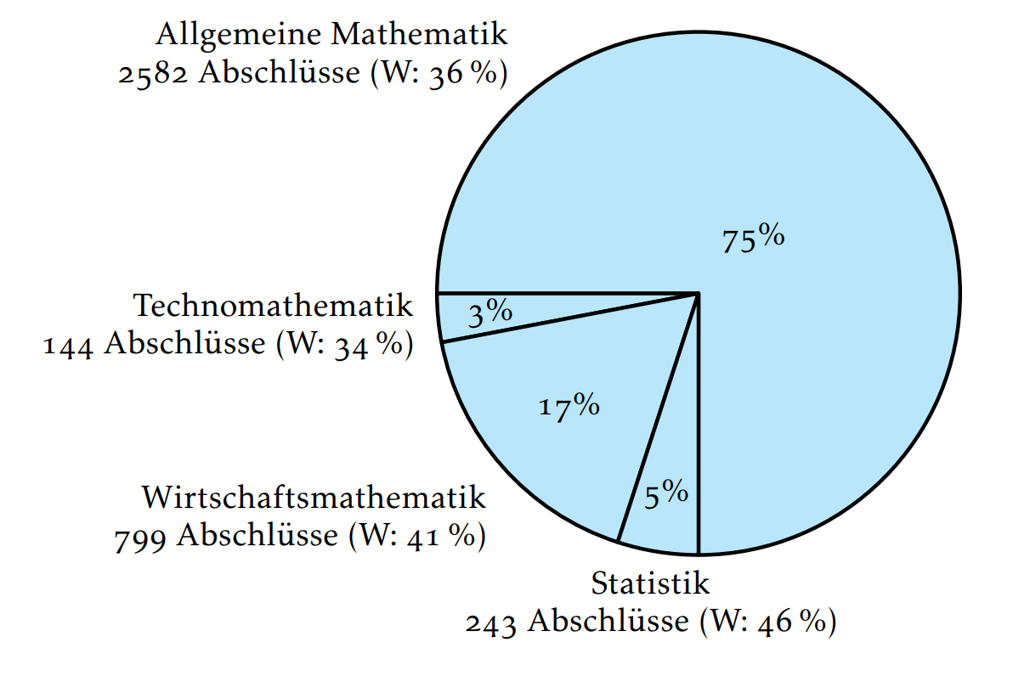
Some figures about the job market 1
I should limit myself to one area: the job market for academics with mathematical qualifications. As in your country, our education system is two-tiered; you can obtain a bachelor's degree after three years; most people add on a two-year master's degree, and you can actually complete your studies in ten semesters.
As in other countries, the Federal Statistical Office (DESTATIS) is responsible for this in Germany. With regard to academic education, we refer to fields of study. The field of mathematics is divided into four degree programmes.
• Mathematics (75%)
• Techno-Mathematics (3%)
• Business mathematics (17%) and
• Statistics (5%)
Techno-Mathematics is an interdisciplinary key science that combines modern applied mathematics, computer science and engineering. Not all universities offer all four courses of study.

Slide 17
Some figures about the job market 2
Let me start with a figure in Germany: There are around 110,000 people of working age who have a university degree in mathematics.
However, our society only has 5,500 members. However, other companies are more successful in retaining university graduates because they have more money. Among the members of our professional societies are, in particular, university employees who are members of the German Mathematical Society (DMV).
Nearly 2.500 -- 3,000 mathematics students graduate from universities each year and enter the job market.
Gender quote: At about 40 %.
One simply has to accept that practizing mathematicians hardly have time to attend long annual meetings which normally last four days. They have a different view of today's working world.
It should also be borne in mind that in practice it is not always about finding the best solution to a problem, but rather the most cost-effective one in line with the framework conditions.

Slide 18
Mathematics and the job market – final remarks
Let me present a few facts and then report on a few trends at the end.
Mathematics is no longer an auxiliary science; mathematicians are conquering new industries.
Stereotypical job profiles are outdated, jobs will be done be AI; but we know that mathematicians are increasingly in demand in almost all industries.
Only very large companies can afford mathematicians, which will then continue to bear the name - mathematician. Since mathematics is needed almost everywhere these days, companies give mathematically qualified people a different name. In Germany, it is difficult to find 10,000 people who can still be called mathematicians.
What should not be forgotten: there are also other talented and highly qualified graduates, e.g. physicists, who are equally qualified as mathematicians.

Slide 20
Review of studies and recommendations 1
Mathematics is not an easy subject, and many problems are difficult; but mathematics must definitely have positive emotional connotations.
Be open to applications. In everyday working life, mathematicians are rarely lone wolves working in isolation in their rooms, no matter how much they love their research. In the professional world, mathematicians are often left to their own devices.
Communication is very important. In mathematics, the results are often held in very high regard, but what is also important and often forgotten is that these results must also be presented in a coherent and generally understandable way.
Willingness and ability to work in a team are essential.
Studying literature is essential, even if you will not find the solution to your problem written down anywhere in full. In application problems, it usually starts with a mathematisation task.

Slide 21
You should know every paper in your research field…
The leading international mathematical databases include
zbMATH Open (formerly Zentralblatt),
MathSciNet (from the American Mathematical Society) and
the preprint archive arXiv.
They offer comprehensive literature searches, reviews, citation analyses and access to scientific publications.

Slide 22
Done …
Last slide…
Good luck with your mathematical research, but also in your choice of scientific friends and partners.
Don't remain a lone fighter and join productive networks, perhaps even in an international context
Work on getting your name known and your work read.
If you think your research questions might interest me, just write me a not too long email
guenter.toerner@uni-due.de
"Kia ora rawa atu"

