Slide 1
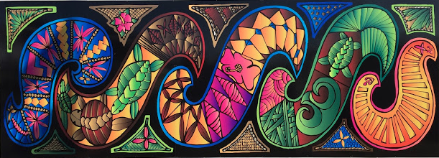
Rongomai Primary created a STEM immersion class in 2016 in order to combat the persistent underachievement of Maori and Pasifika children in traditional school settings.

Slide 2
What does STEM look like in primary?
Coding, design, robotics, environmental work and at the core of this all is science!

Slide 3
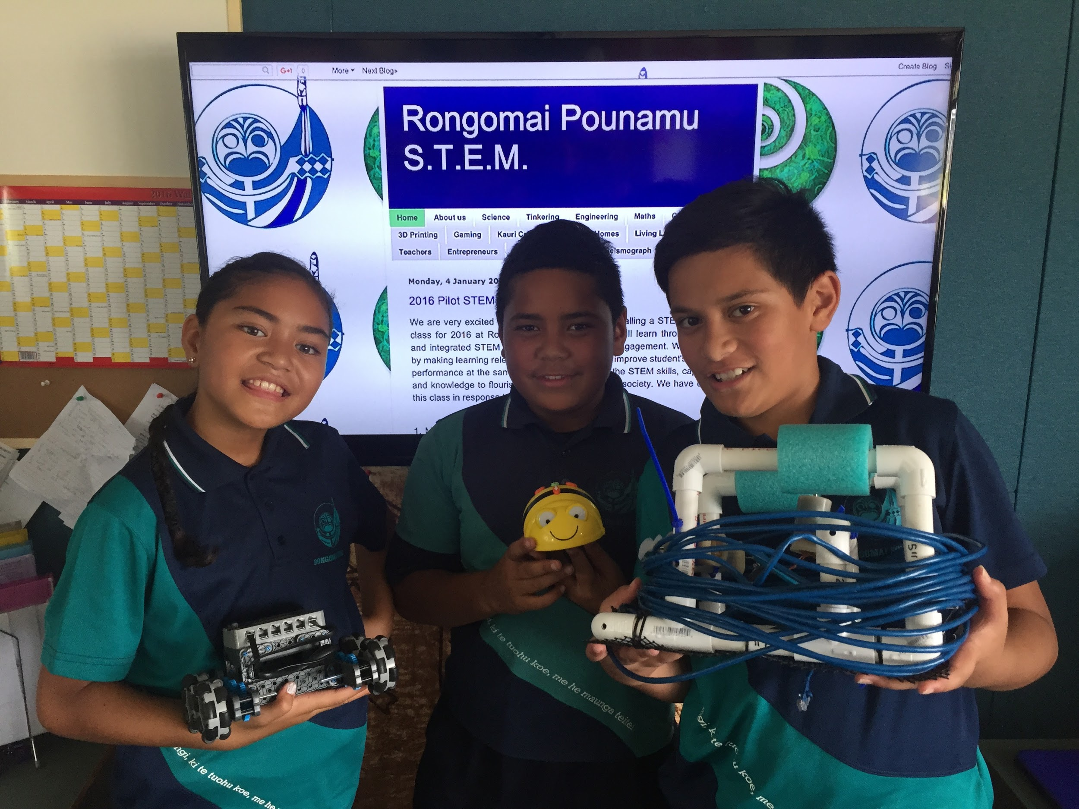

Slide 4
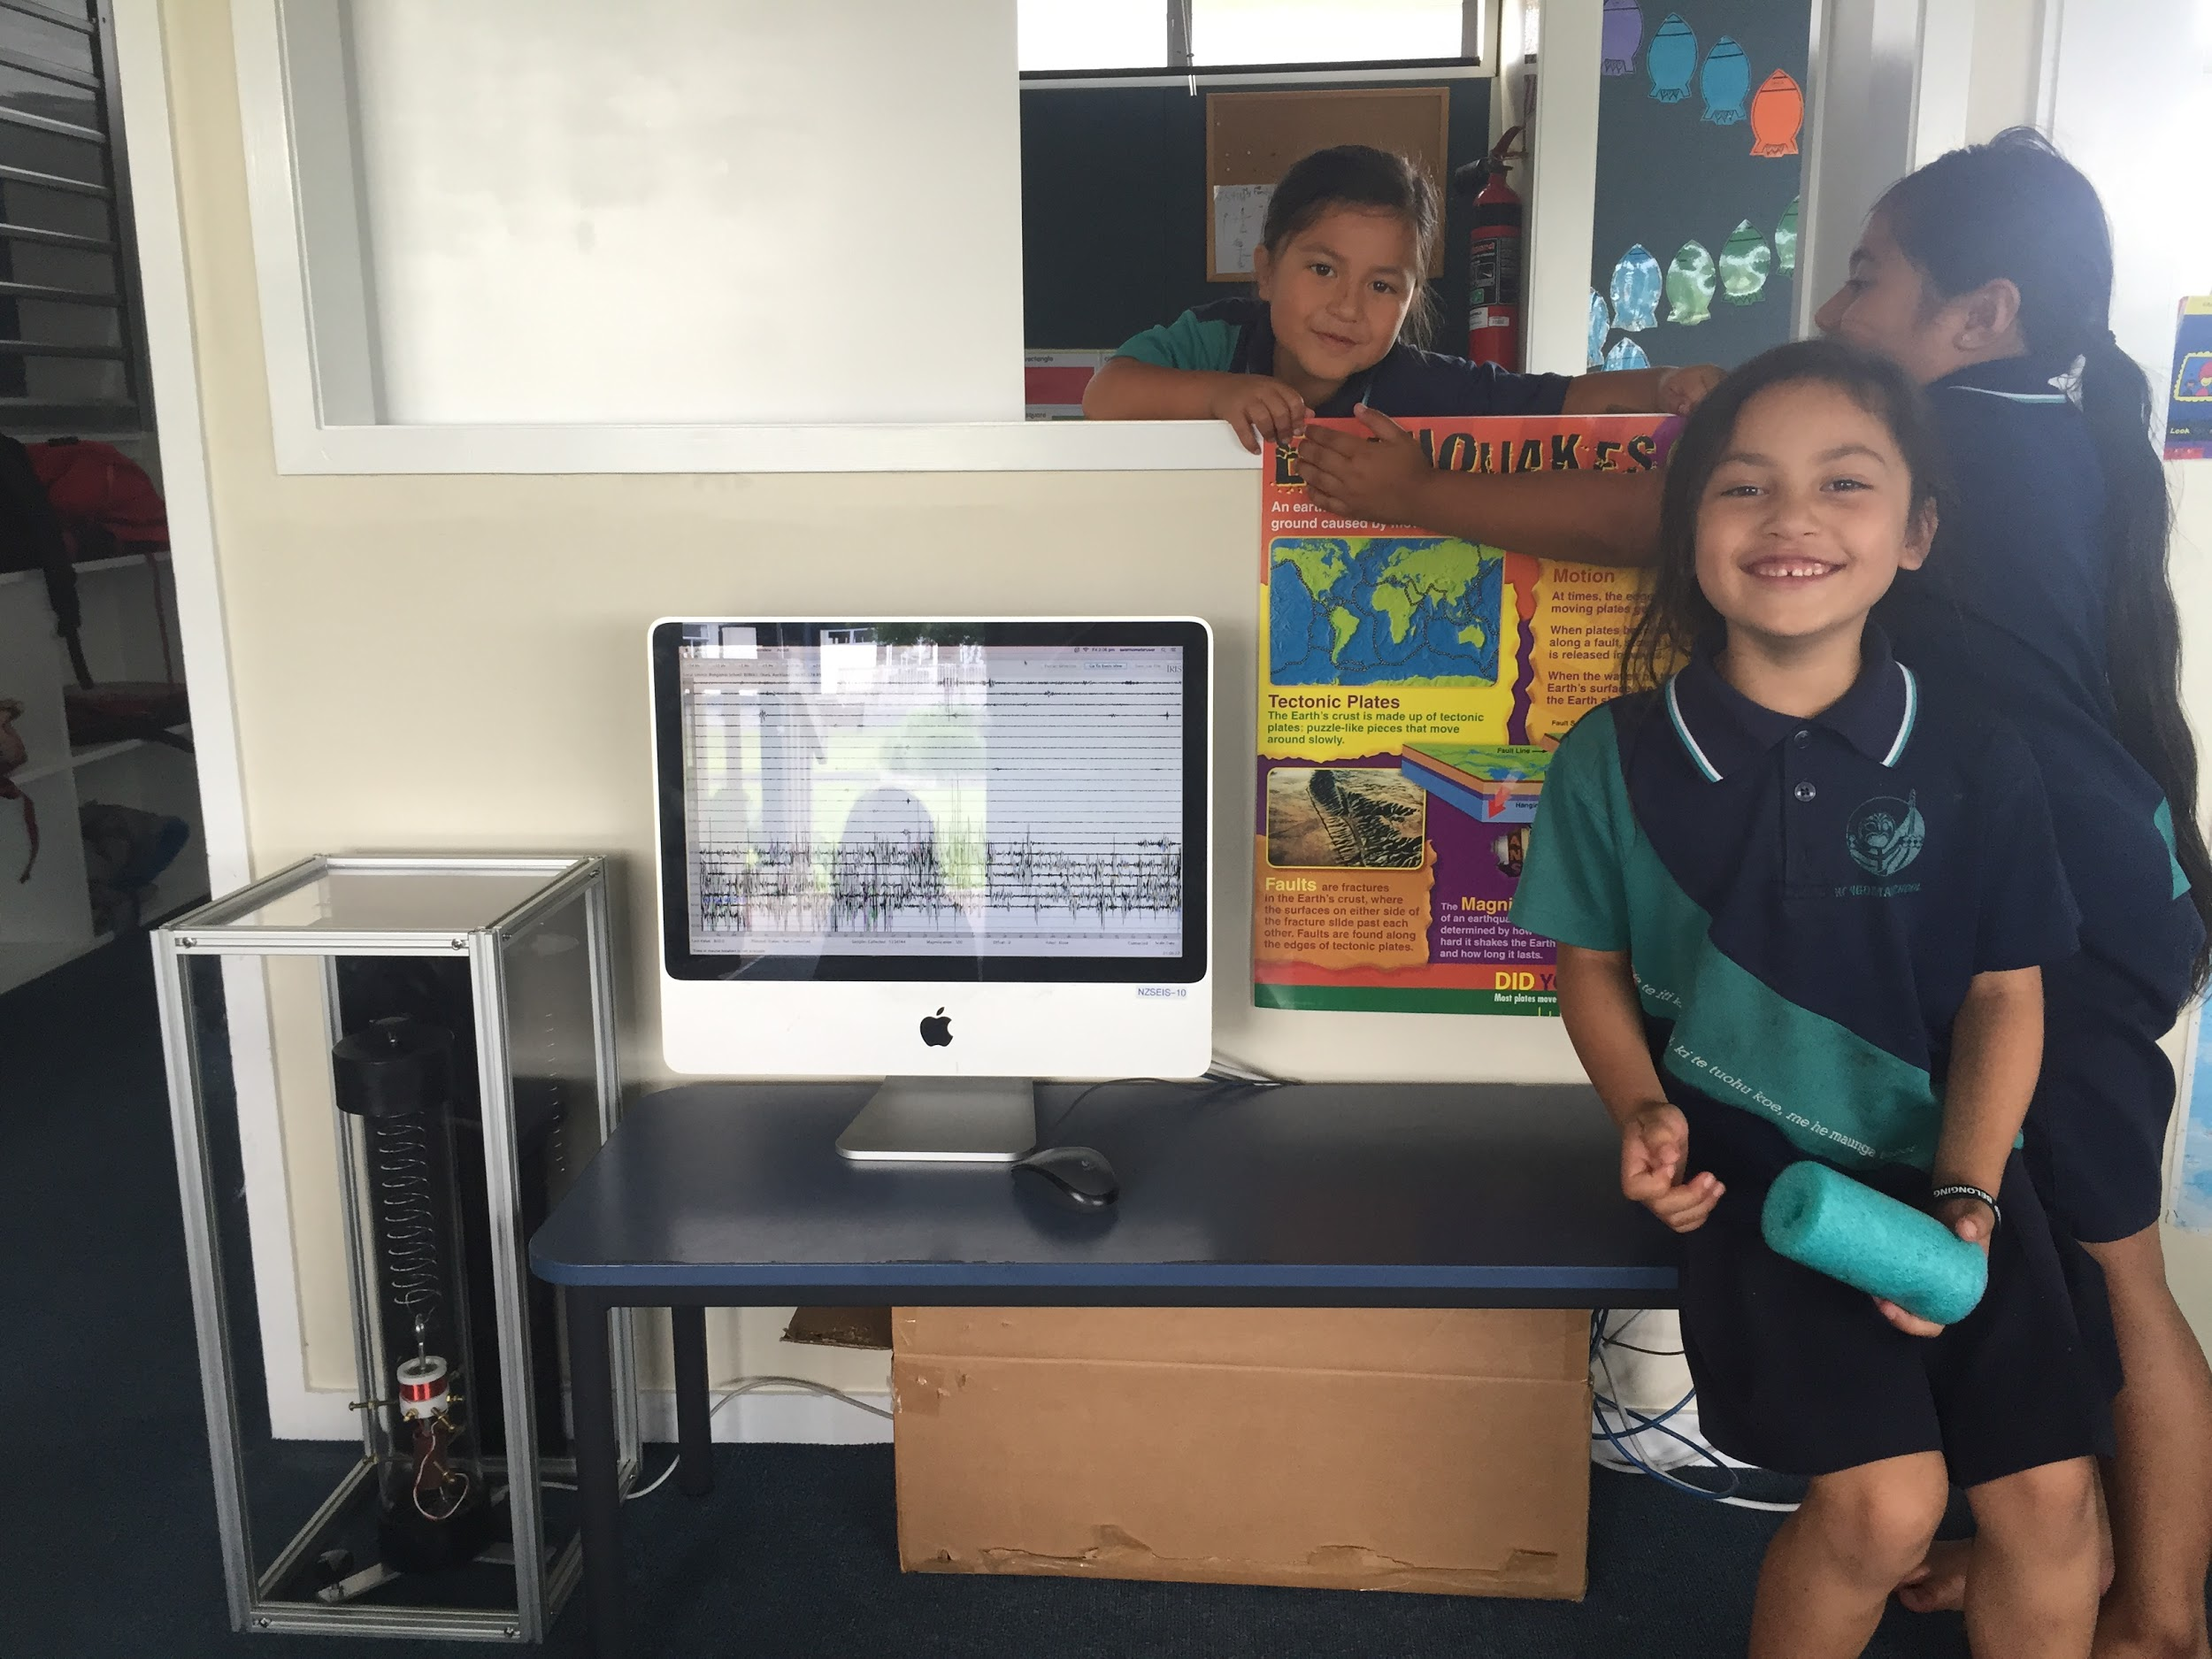

Slide 5
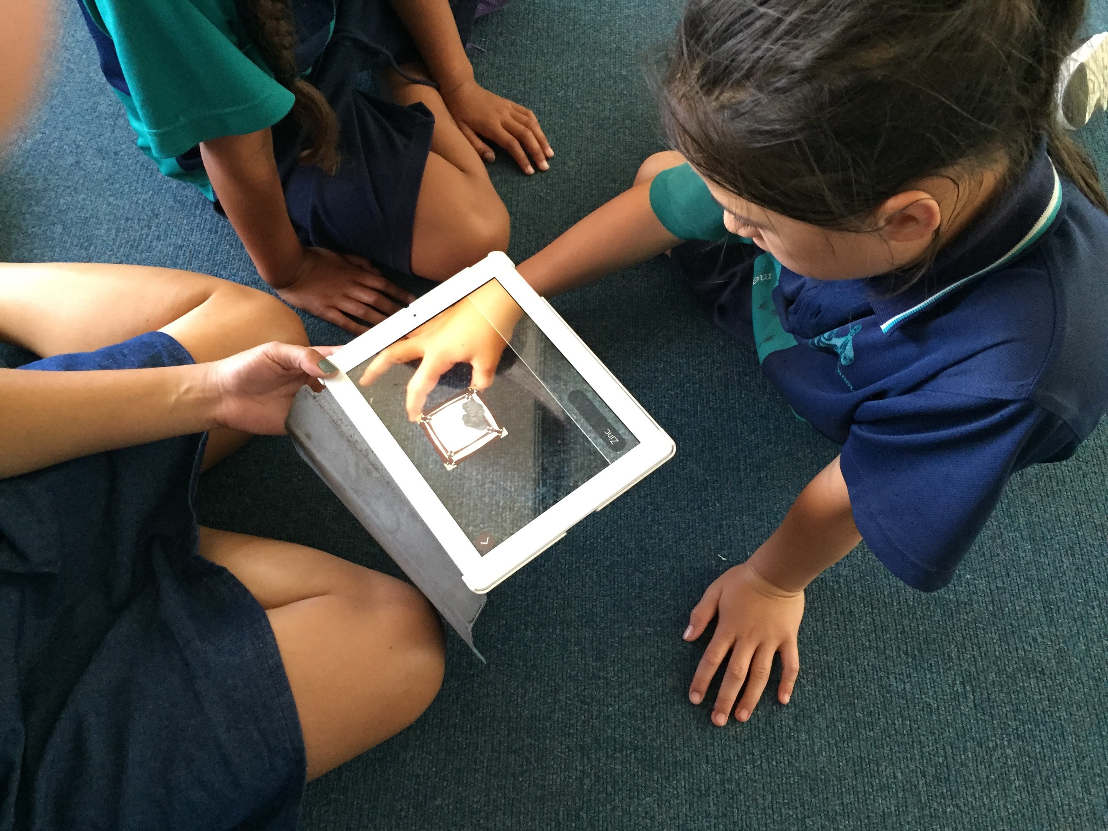

Slide 6
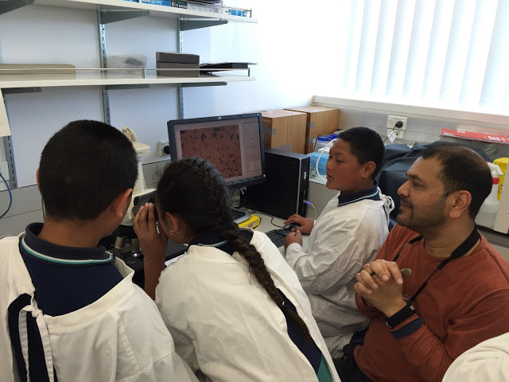

Slide 7
What does entrepreneurship look like in primary?

Slide 8
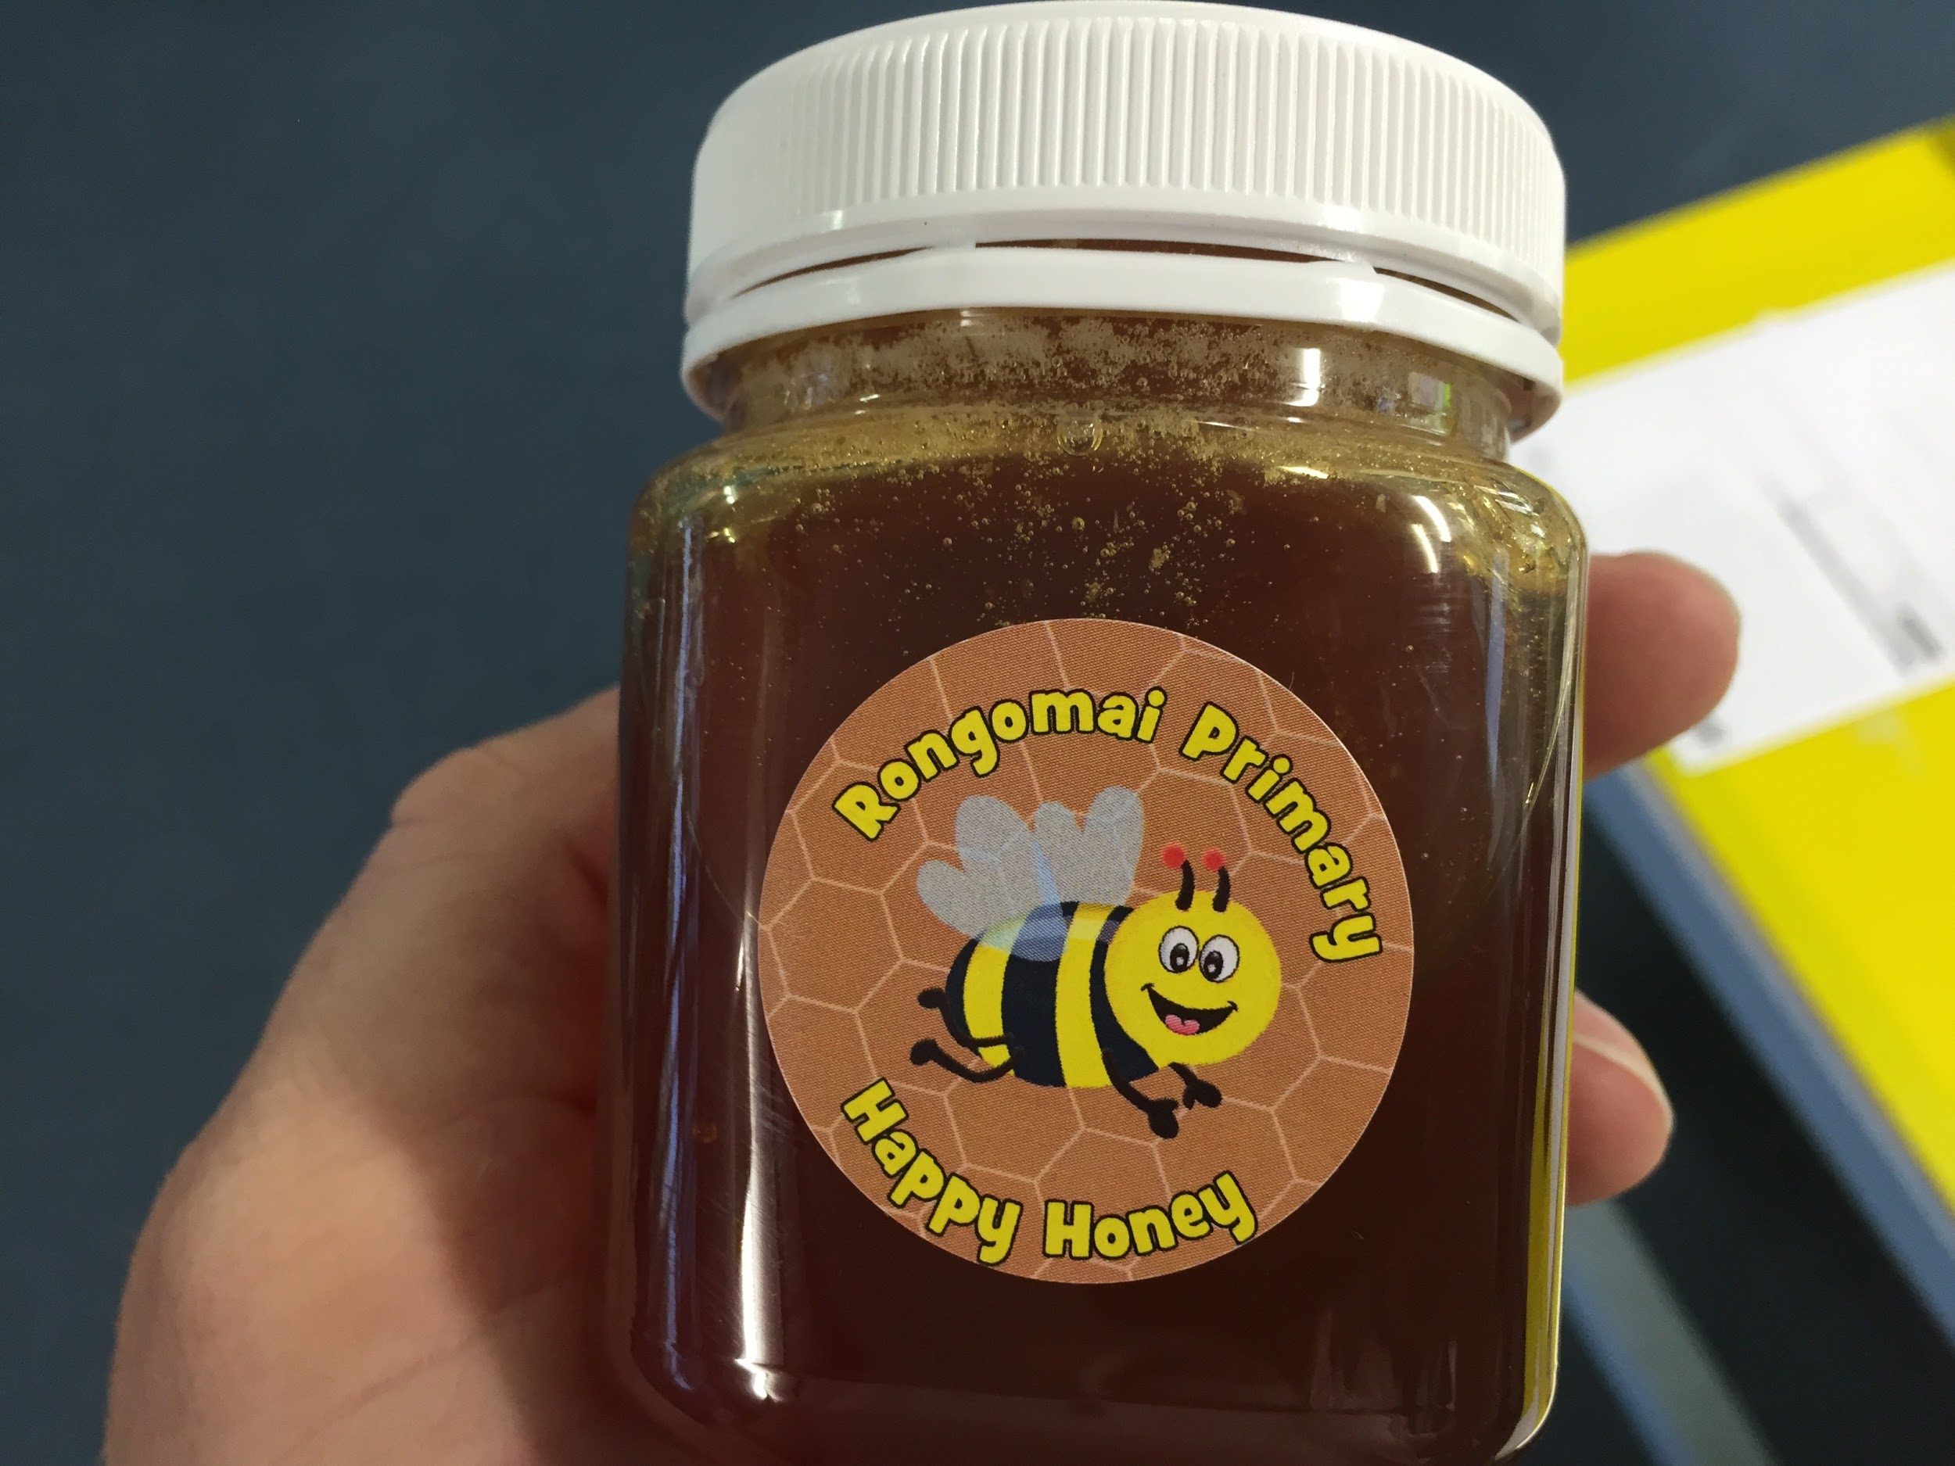

Slide 9
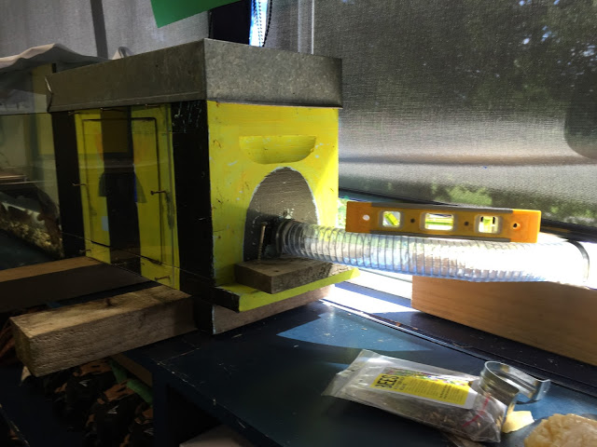

Slide 10
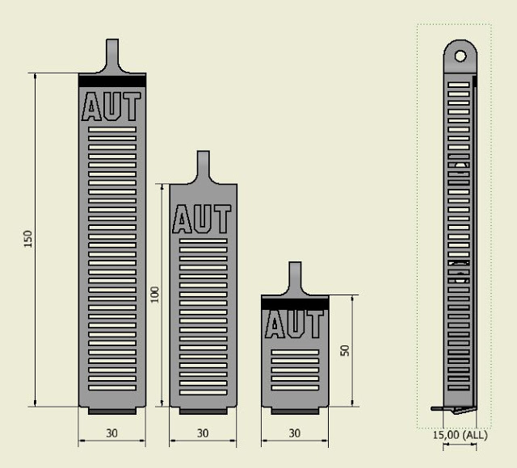
3D Printed Prototypes

Slide 11
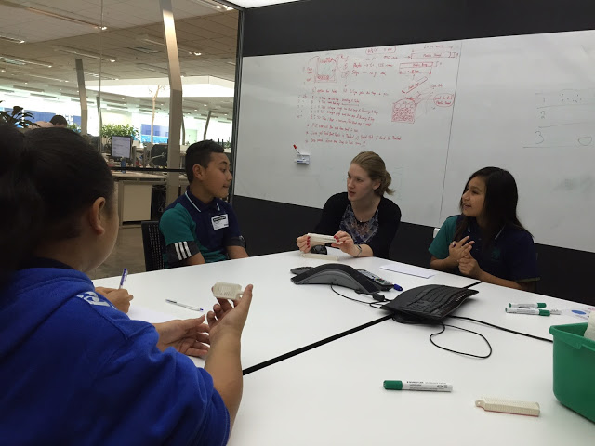

Slide 13
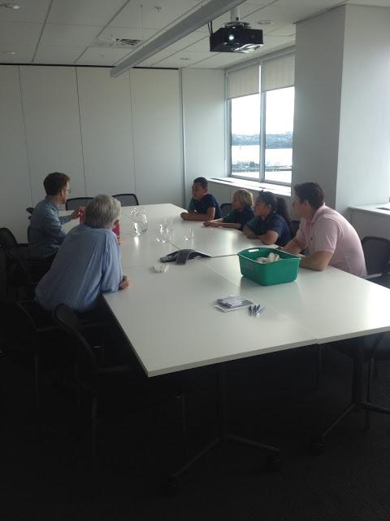

Slide 14
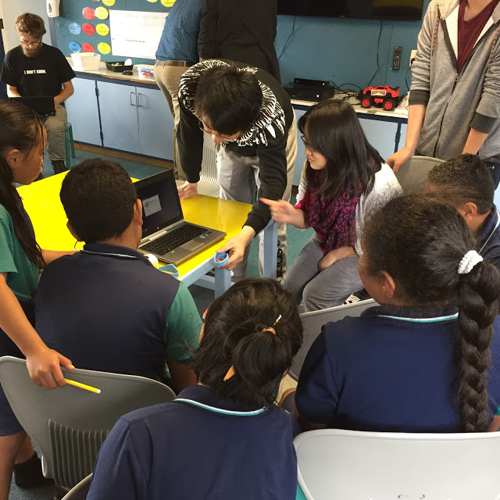
RFID

Slide 15
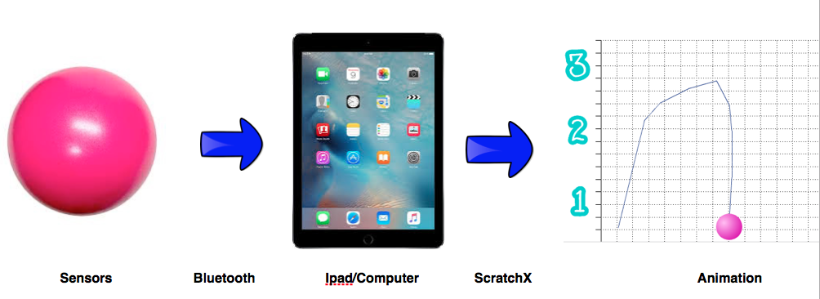

Slide 17
Any Questions

