Slide 1
IT-based
Knowledge Management
Wismar Business School
KIWI – Artificial Intelligence in Business Informatics Uwe Lämmel www.wi.hs-wismar.de/uwe.laemmel www.hs-wismar.de

Slide 2
Content
Wismar University – Business Faculty – Business Informatics
knowledge – knowledge management
business rules
knowledge networks
semantic wiki

Slide 3
Uwe Lämmel, Prof. Dr.-Ing.
1981 Diplom, Mathematics, Rostock University (1418)
1985 PhD (Dr.-Ing.) Rostock University
1985 – 1995 Department of Comp. Sc. , Univ. Rostock
since 1996 at Wismar Business School, a faculty of Hochschule Wismar:
Informatics / Artificial Intelligence

Slide 4
Uwe Lämmel, Prof. Dr.-Ing.
Teaching
Introduction in to programming (Java)
Knowledge-based Systems
Knowledge Extraction (Data Mining)
IT in Business
Mobile Agents (LEGO robots and Java)
Research Methodology
Head of degree programme: Master of Business Systems
Distance learning, contact sessions in Cape Town

Slide 5
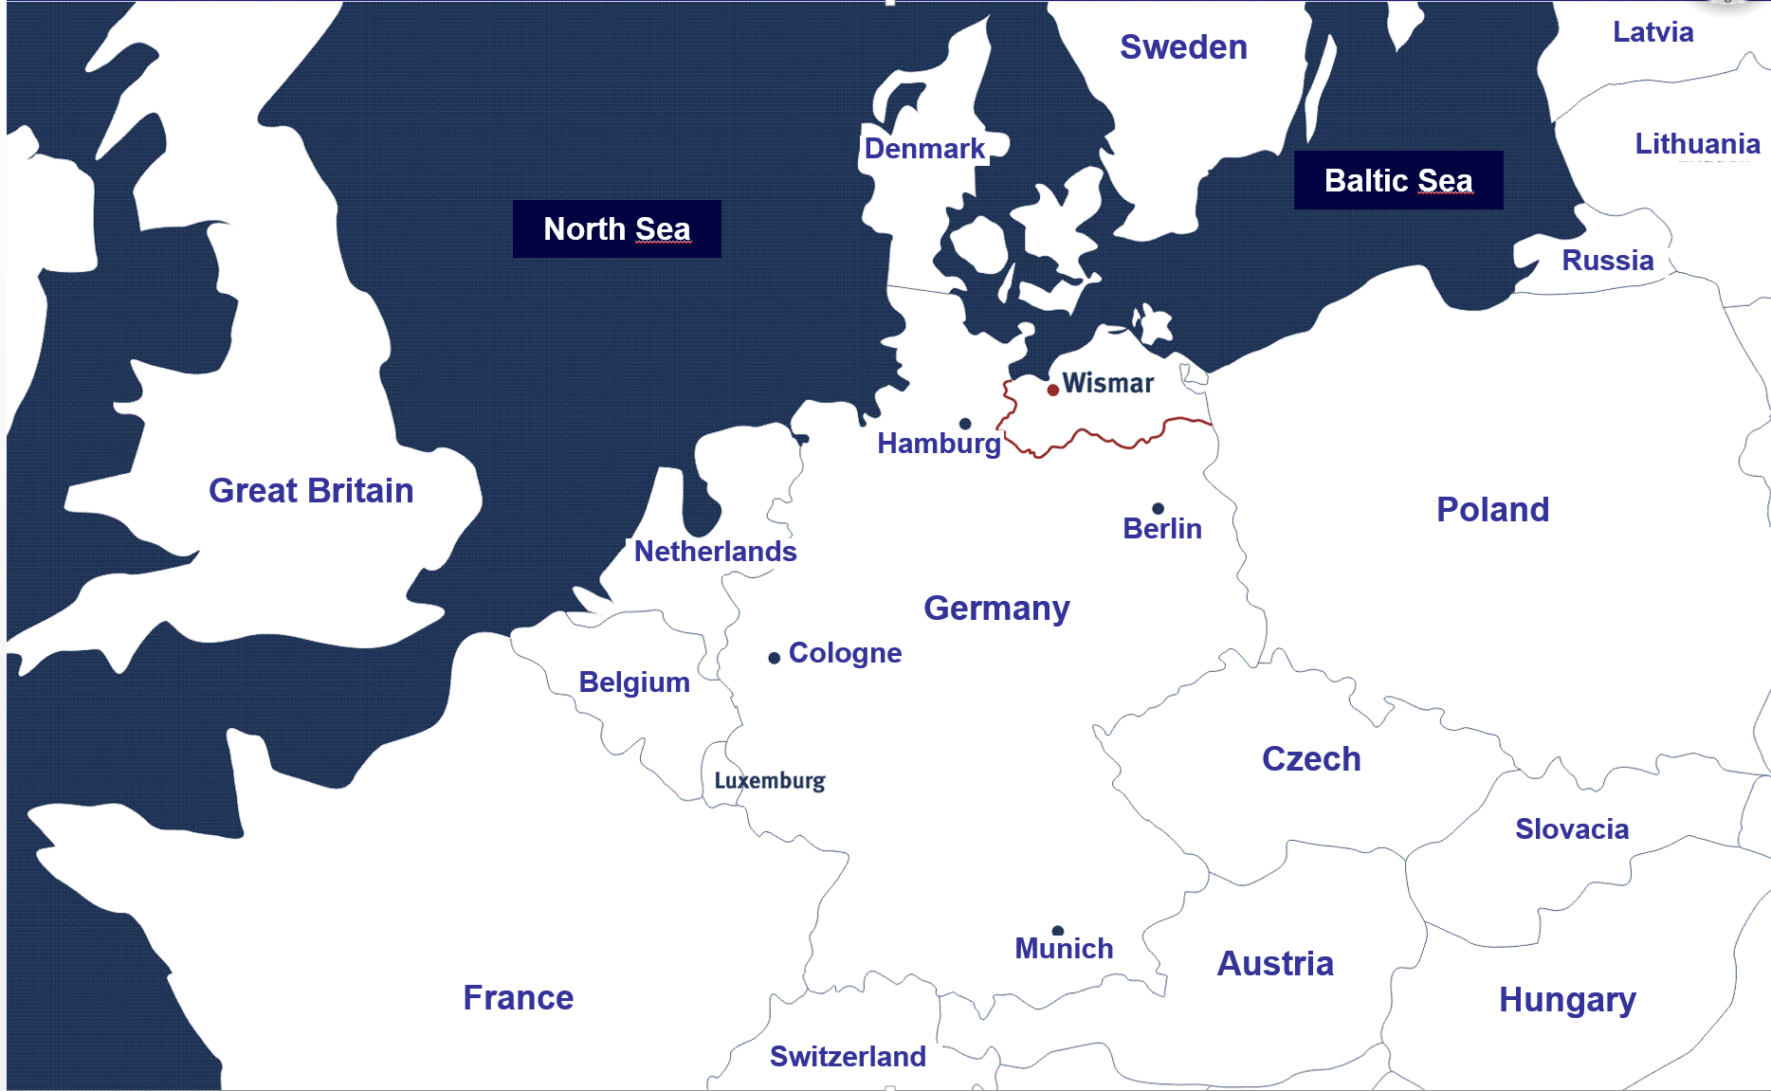
Wismar in Europe

Slide 6
Hochschule Wismar
University of Technology, Business and Design
1908 Engineering Academy
3 Faculties
Engineering – Business – Design
~ 8.000 students (~ 4.000 distance learning)
2nd largest public univ. in distance learning in Germany
Munich, Frankfurt, Hannover, Berlin, Hamburg …

Slide 7
Institute BIT: Business Information Technology
Jan Helmke (Head) ERP, SAP, Business Processes
Erhard Alde SW Engineering, Business Processes
Rüdiger Blach Operating Systems, Networks
Jürgen Cleve AI, Data Mining
Uwe Lämmel
Harald Mumm Application Programming
Rüdiger Steffan Database Systems
Reinhard Weck Informatics and Society
Bernd Wagner Logistics
N.N. Business Informatics

Slide 8
KIWI
Artificial Intelligence in Business Informatics
People
Jürgen Cleve
Uwe Lämmel
students
Projects
Data Mining Engineering
Applications of Neural Networks
Knowledge Management
Business Rules
Knowledge Networks
Semantic Wiki
Printing
Lämmel, Cleve: Artificial Intelligence, 4th ed., 2012 (German)
Cleve, Lämmel: Data Mining, 2nd ed. 2016 (German)

Slide 9
x
virtual(x)
is_there(x)
can_see(x)
Gottlob Frege
1848 Wismar – 1925 Bad Kleinen
Professor at University in Jena
mathematician, logician, philosopher
mathematical logic (predicate calculus)
analytic philosophy
1878 Begriffsschrift
Objectives
education in Math
Logic
heritage
People
pool of enthusiasts, mainly mathematicians

Slide 10
Content
Wismar University – Business Faculty – Business Informatics
knowledge – knowledge management
business rules
knowledge networks
semantic wiki

Slide 11
Knowledge
a awareness or familiarity gained by experience (of a Person, fact, or thing) (Have no knowledge of that). b a person’s range of information (is not within his knowledge).
a ( usu. foll. by of) a theoretical or practical understanding of a subject, language, etc. (has a good knowledge of Greek) b the sum of what is known (every branch of knowledge).
Philos. true, justified belief; certain understanding, as opposed to opinion. …”
Oxford Illustrated Dictionary

Slide 12
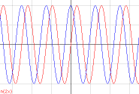
Message – Data – Information – Knowledge
Knowledge
... is information I can apply
IF turnover(X) > 1.000€ THEN goodCustomer(X).
Information
Data + meaning (for receiver)
turnover 1.250€
Data
transmtted by a message
digital character
1.250
Message
sequence of signals

Slide 13
Knowledge
A system S has knowledge K,
if S, whenever necessary,
applies K.
More&Newell,1973

Slide 14
Knowledge Management
„… is the science of
- systematic acquisition,
- use and
- storage
of expertise and information to improve
- efficiency,
- competency,
- innovation and
- reaction capacity
of the organisation.“
Brüggemann-Klein, A.; Schlichter, J.: Wissensmanagement in Organisationen, Vorlesung des Lehrstuhls für Angewandte Informatik / Kooperative Systeme, München:Technische Universität, 1999.
Notes:
Sehr aufwendige (umständliche) Definition

Slide 15
Knowledge Management
„… includes all
methods,
tools and
critical aspects of an organisation,
which are necessary for its
adaptation,
protection and extension of competencies
to react effectively and efficiently on market changes,
which do not occur continuously or centralised.“
Brüggemann-Klein, A.; Schlichter, J.: Wissensmanagement in Organisationen, Vorlesung des Lehrstuhls für Angewandte Informatik / Kooperative Systeme, München:Technische Universität, 1999.
Notes:
Sehr aufwendige (umständliche) Definition

Slide 16
If only X knew what X knows
X = { Siemens, HP, Texas Instruments, Sony, your company, we, you, I, everyone, Berlin, … }
provide knowledge wherever and whenever it is needed

Slide 17
Knowledge Representation
text
picture/figure
logic (rule)
network
neural network

Slide 18
Theory versus Practice
Theory
mostly well known and established
Practice
not widely used
Why?
not so easy to use
not well supported
What to do?

Slide 19
Content
Wismar University – Business Faculty – Business Informatics
knowledge – knowledge management
business rules
knowledge networks
semantic wiki

Slide 20
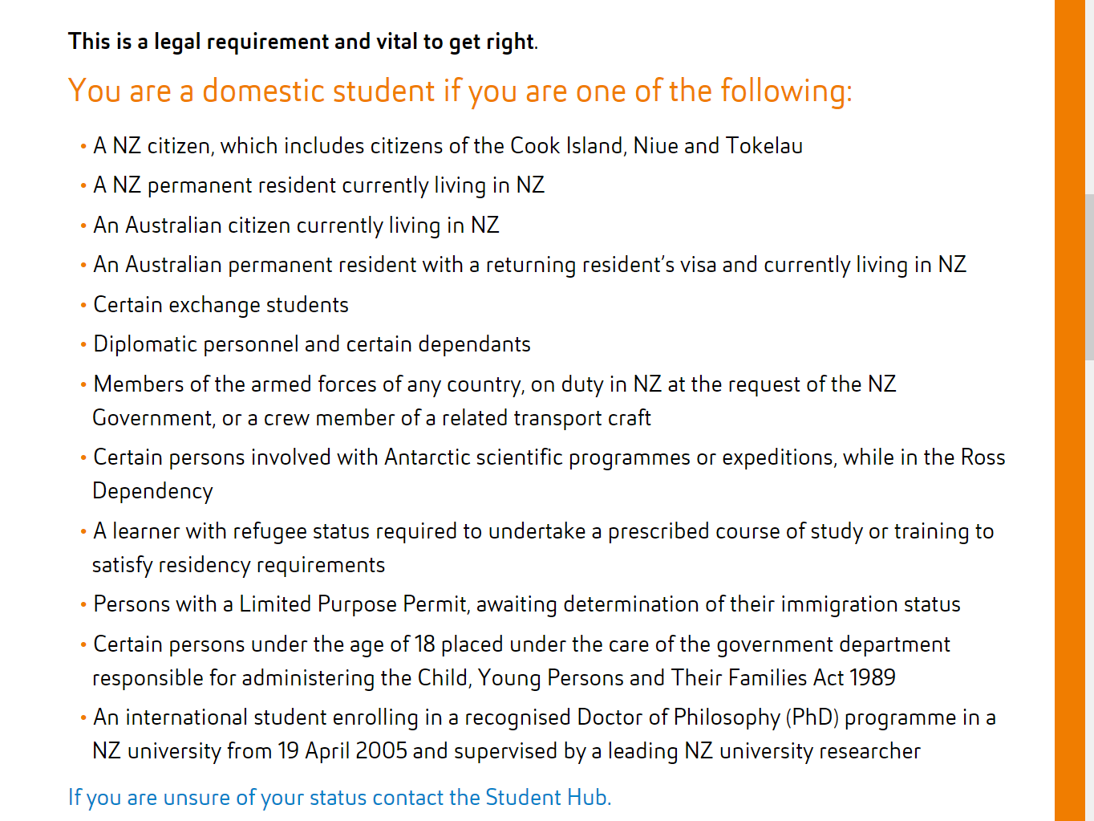
Business Rules
IF X is a customer THEN send a bill.
IF not X is a customer THEN cash on delivery.
IF X is a good customer THEN give a discount.
IF annual turnover X > 1.000 THEN X is a good customer.
Real world?
AUT: Is someone a domestic student?

Slide 21
Why Business Rules?
Enterprise Impact |  | Business Value
business agility |  | – faster reactive time to market
decision making |  | – rule-based scenarios at lower cost
revenue opportunities |  | – greater product, pricing and service flexibility
customer satisfaction |  | – more customizable product and service offerings
regulatory compliance |  | – greater visibility to regulatory bodies and easier change processes
Gardner Group

Slide 22
BRMS-Produkte
Blaze Advisor
ILOG
JBossRules
Mandarax
Oracle Business Rules
QuickRules
Visual Rules

Slide 23
conclusion
rules seems to be easy
BRMS available
high costs
software
training
required
rule thinking ➔ teaching
easier to use systems (at lower costs)

Slide 24
Content
Wismar University – Business Faculty – Business Informatics
knowledge – knowledge management
business rules
knowledge networks
semantic wiki
conclusion

Slide 25
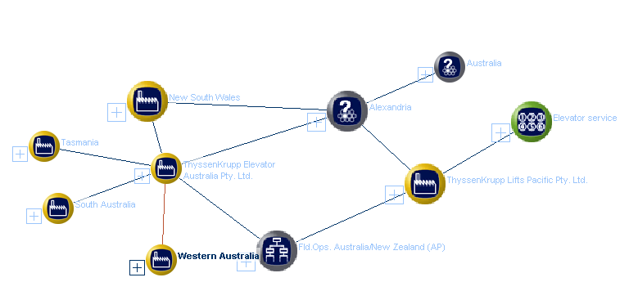
Topic Map Example: Thyssen Krupp
Netnavigator
base.thyssenkrupp.com

Slide 26
Topic Map
is famous for
Country
Cuisine
is a
is a
New Zealand
China
is famous for
Germany
is famous for
Food
Drink
Bread
Rice
Wine
is famous for
Beer
Vodka
topic (notion, concept, class, category…
association (link, relation)
instance (element, object)
occurrence – link to data, e.g. url

Slide 27
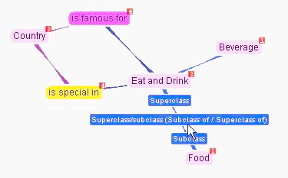
Country is famous for cuisine
Topic Map in Ontopia
www.ontoppia.net

Slide 28
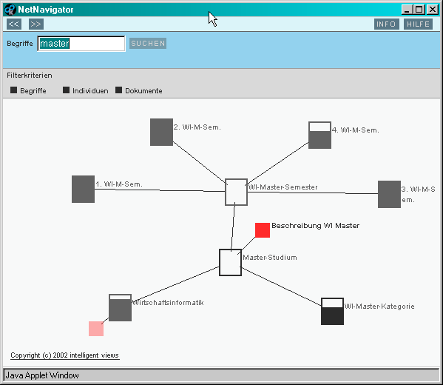
ToMaHS
Project
Topic Maps für Hochschul-Strukturen
degree programmes in Business Informatics
university adminsitration

Slide 29
Topic Map: Business Informatics
Bachelor BI – compulsory module
extends instances of
Degree programme
subnotion of
Modules
is a
2nd term
subnotion of
Wismar Business School
instance of
contains
subnotion of
Data bases and data modelling
subtype of
Professor
teaches
Special Subjects
is a
is covered in
Rüdiger Steffan
Business Informatics (BI)

Slide 30
conclusion
topic maps enable semantic search
concept like sentences ➔ seems to be easy
(a few) software exists
creating a topic map ➔ a lot of effort
required
easier to use systems (at low costs)
links, interfaces to other systems
automatic generation of backbones

Slide 31
Content
Wismar University – Business Faculty – Business Informatics
knowledge – knowledge management
business rules
knowledge networks
semantic wiki
conclusion

Slide 32
Semantic Wiki
wiki = positive (Wikipedia)
annotations
attributes (type)
enable semantic search
database like queries
can be used to define associations
https://kompetenz.hs-wismar.de/index.php/Semantic_Wiki_Example

Slide 33
Semantic Wiki
Topic map can be mapped into a semantic wiki
topic = category (wiki page)
association = annotation of type “Page”
instance = wiki page that belongs to a category
occurrence = page text and links
wiki page Italy:
'''Italy''' is famous for [[is famous for::Pasta]].
[category: Country]

Slide 34
Semantic Wiki for Knowledge Management
ongoing project
Competence Portal: http://kompetenz.hs-wismar.de
idea:
everybody puts in his/her own publications, projects …
more freedom than in a database
easier to use than existing systems
annual reports will be generated
reality:
only used by some colleagues (they are happy)

Slide 35
Conclusion
many people feel the lack of a proper KM
formal knowledge representation can improve KM
existing concepts lack user friendly usability
What can be done to bring KM to everybody?
Ideas
(semi-)automated generation of formal knowledge representations:
people write wiki pages
categories, associations are identified by the system
experts build Topic Map (TM) ➔ TM is used as a backbone for a semantic wiki ➔ visualisation of a semantic wiki (like TM)
KM = knowledge management

Slide 36
Thank You for your patience
It is not sufficient to know, you have to apply as well, it is not sufficient to intend to do, you have to do it.
Johann Wolfgang von Goethe
Uwe Lämmel
Hochschule Wismar
Wismar Business School
www.wi.hs-wismar.de/uwe.laemmel
uwe.laemmel@hs-wismar.de

Slide 37
Abstract
IT based Knowledge Management
Since the hype of Web 2.0 the discussion on knowledge management has focused on the application of social media. However, a real management of knowledge using computers requires a (semi-) formal representation of knowledge. Thus enabling knowledge processing.
The paper presents the possibilities of formal knowledge representation and discusses their usability: business rules as well as topic maps or semantic wikis will be discussed.

Slide 38
Abstract
IT based Knowledge Management
Wissensmanagement wird seit vielen Jahren in Forschung und Praxis stark diskutiert. Mit dem Hype des Web 2.0 erlebte diese Diskussion einen weiteren Höhepunkt, die die (damals) neuen sozialen Medien in den Mittelpunkt rückte. Ein echtes Management von Wissen mittels IT setzt jedoch (semi-) formale Wissensdarstellungen voraus, die dann zudem eine Verarbeitung von Wissen ermöglichen.
Der Beitrag stellt die Möglichkeiten der formalen Wissensdarstellung in den Mittelpunkt und diskutiert deren Praxistauglichkeit. Dabei wird auf die Erfahrung aus verschiedenen Projekte zurückgegriffen.

