Slide 1
From Ph.D. to Start-Up: My Experience
Jonathan Currie
Inverse Problem Limited
www.inverseproblem.co.nz

Slide 2
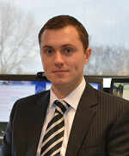
Company Overview
Inverse Problem Limited (IPL)
Formed October 2012
3 Directors, 4 Shareholders
Technology Start-Up
Two Products (one too many)
Profitable Since 2012
Won the 2012 AUTEL Innovation Challenge
Received a 35K Pre-Incubation Callaghan Grant
Associate Professor David I Wilson
Executive Director
Dr. Jonathan Currie
Technical Director
Dr. Arrian Prince-Pike
Technical Consultant
Shareholder

Slide 3
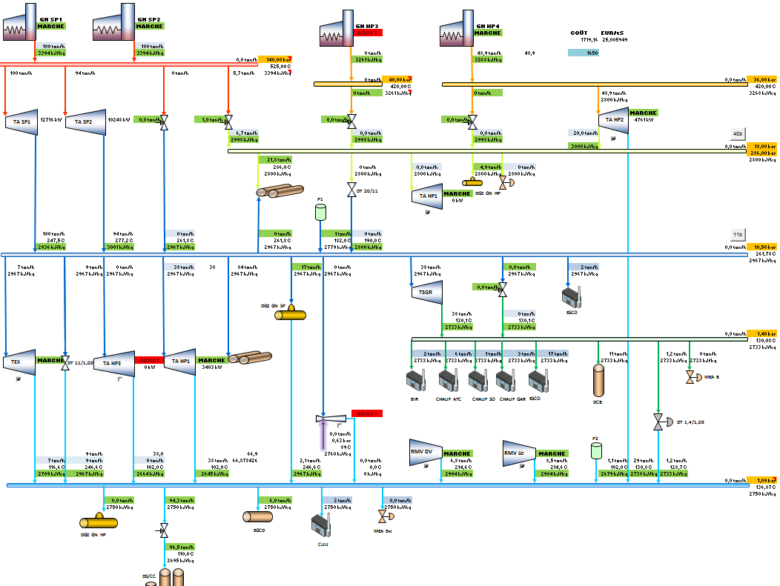
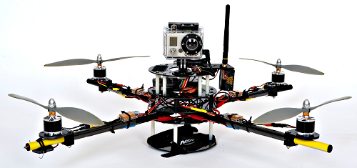
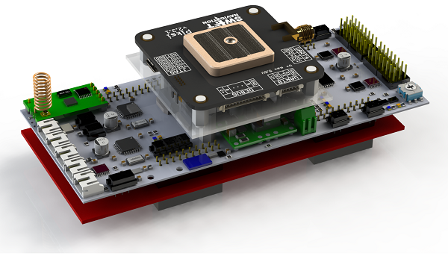
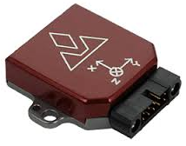
Our Technology Portfolio
JSteam Utility Modelling Software
jMPC UAV Control Platform
Status: Currently sold internationally via our website. Continuously upgraded with major release due by 2016.
Status: Currently developing our first hardware prototype. First flight anticipated by October 2015.

Slide 4
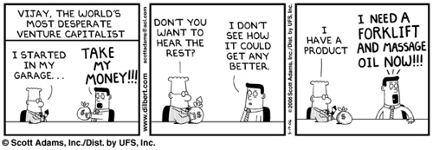
Our Commercialisation Experience
The next few slides will detail our commercialisation experience in approximately chronological order
Order and content may not always be advisable…
However our lessons learnt may help you

Slide 5
Pulling Finger
Internally, we had often discussed the idea of commercialising something
But it was always something that was in the ‘too hard basket’ or ‘when I get some more time’
Our real change of focus came with the AUTEL Innovation Challenge – a chance to not only win an appreciable amount of money, but also to focus our efforts on the business side of things
In 2012 we won the Inaugural AUTEL Innovation Challenge, securing 20K funding as well as forming a very valuable relationship with AUTEL.
“
”
Lesson Learnt (A): Get moving!
Lesson Learnt (B): You need an advisor!
http://www.autel.aut.ac.nz/innovation-challenge

Slide 6
Starting a Start-Up
We formed Inverse Problem in 2012 to strengthen our AUTEL entry
Whether you need to form a start-up company depends on many factors – type of product, market, business model
There are lots of other means to commercialize technology!
License your product
Build with the aim to sell
Patent and extract royalties
Knowing what option to take is hard for those with minimal business experience
We thought we knew exactly what we were doing… I mean we were engineers!
Lesson Learnt: Being an engineer won’t help with income tax returns, no matter how good at maths you are

Slide 7
Hi-Tech Awards
Buoyed by our success winning the AUTEL challenge, we decided to enter the NZ Hi-Tech Awards
Not surprisingly we didn’t place anywhere
No income, beginner business plan, confusing product…
However I sent David along to the gala event where he met some “business types” and was invited for a free business consultation
Make sure you have a “David” in your company
Lesson Learnt: Network!
http://www.hitech.org.nz/

Slide 8
Look Who’s Talking
Our business consultation turned out to be with PwC – a large multinational business advisory company
We went along for our free hour where they asked us a lot about our company, our products, ourselves, our finances, and so forth
With our hour up, we realised we had learned very little
A half day follow up meeting was proposed for $3500….
Lesson Learnt (A): Don’t do all the talking
Lesson Learnt (B): This is an expensive game…
http://www.pwc.co.nz/

Slide 9
The End of Faking It
At this point I started to get quite enthused about “running a business” and “being an entrepreneur”
I mean it couldn’t be long before we were millionaires?
The critique of our company had already started; “what, everyone is an engineer?”
Having family with other professional skills didn’t seem to cut it
An opportunity came up to attend an innovation and commercialisation course at UoA.
While a fantastic course, I realised we would need a lot of support to get off the ground
Lesson Learnt: You need business people around you
http://www.gsm.auckland.ac.nz/cie/programmes/phd

Slide 10
Finding the Right Match
We started looking for a partner to assist with market research, market validation, management structure and provide a bit more direction for the company
Through AUTEL, we were introduced to Swiftsure
A relatively new investment company run by two successful ex CEOs.
After several (free) meetings, Swiftsure proposed starting a new company with equal shareholding between IPL and Swiftsure
We develop the technology, they ‘do the rest’
Based on advice we received, we declined their offer
Lesson Learnt: You don’t have to take the first investment opportunity
http://swiftsure.co.nz/

Slide 11
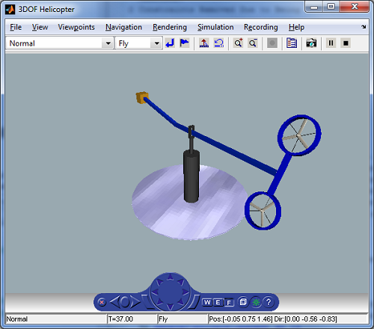
IP Review: Open Source IP is not IP
As a wide-eyed Ph.D. student wanting to help the whole word, I had released all my control algorithms as open source software
I had even written the website to enable it to be downloaded easily!
It is a bit hard to make money from something you already give away for free
People don’t often push the ‘donate’ button
Investors won’t like this either (at all)
Thankfully early software implementations were naïve and later performance upgrades were kept as closed source
Think carefully how much information you give away in your thesis…
Lesson Learnt: Talk to someone about IP early!

Slide 12
Pre-Incubation
Our first successful investment round was with PowerHouse Ventures, introduced again by AUTEL
We entered a 3 month pre-incubation phase funded by a 35K Callaghan Innovation grant
The grant was to identify whether or not we had something worth investing in
PowerHouse helped us narrow our product’s feature set from a “solve everything” approach to a UAV controller
I also got around the country to meet a lot of fellow researchers and engineers
Ultimately no investment resulted due to needing a proof of concept, but they are keenly waiting our first prototype
Lesson Learnt: Picking your investment timing is critical
http://www.powerhouse-ventures.co.nz/

Slide 13
Take Away Points
Get involved with AUT Enterprises Limited (AUTEL)
100% without a doubt the reason we have got as far as we have
Mitali and her team are knowledgeable, experienced, and fun!
Start talking to potential collaborators/co-founders early
1 man (or woman) companies are less attractive to investors
You need a multi-disciplinary team
Get out there are ask what people want and need
Remember the vitamin vs painkiller analogy
Attend as many commercialization and entrepreneurial events as you can
You need to learn the lingo, and you might meet some useful people
And finally – get off the couch! (or out of the garage, as the case may be)
If you have an idea – give it a go!

Slide 14
Questions?

