Slide 1
Academia and Entrepreneurship: How to Start and Run a Technology Company
Zbigniew Michalewicz

Slide 2
Outline of the Talk
Introductory remarks
SolveIT Software story
Concluding remarks

Slide 3
Outline of the Talk
Introductory remarks
SolveIT Software story
Concluding remarks

Slide 4
Core Philosophy
OUTCOME (“Learning”)
D
A
T
A
I
N
S
I
G
H
T
OPTIMISATION
D
E
C
I
S
I
O
N
DATA
MINING
PREDICTION
Past
Future

Slide 5
A thought from the past
“There is a greater need for decision-making systems that can learn and adapt effectively than there is for optimizing systems that cannot.”
R. Ackoff, The Future of OR is Past, JORS, 1979.

Slide 6
Text
Adaptive Business Intelligence (ABI) – three major components:
Prediction
Optimization
Adaptation
6
Notes:
6

Slide 7
ABI in action: 2002
General Motors sells 1.2 million off-lease cars each year on various auction sites.
Each day, a remarketing team uses business intelligence tools and reports to decide where to ship 4,000 – 7,000 off lease cars.
The problem is impacted by demand, depreciation, transportation schedules, cost of capital, risk, changes in market conditions, recent decisions, and the volume effect.

Slide 8
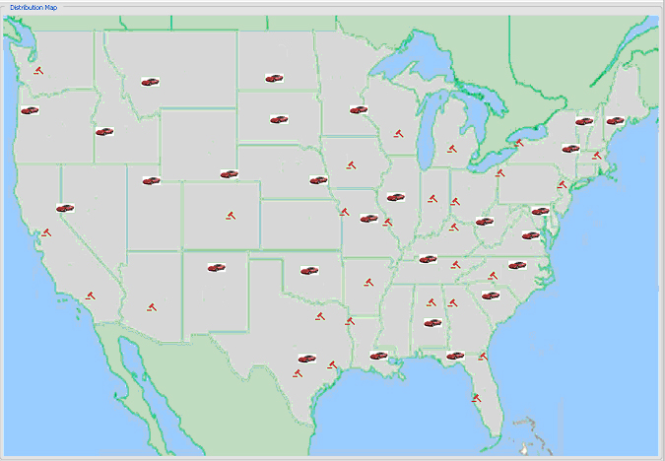
Car Distribution System

Slide 9
Applications
When a software project is successful?
There is only one criterion… A software project is successful if the system is “in use”…
A scientist developed food for dogs…

Slide 10
Outline of the Talk
Introductory remarks
SolveIT Software story
Concluding remarks

Slide 11
In Search of Focus (driven by market)
Optimisation
Optimised planning & scheduling
Optimised planning & scheduling for supply chains
Optimised planning & scheduling for process supply chains (grain, wine, milk)
Optimised planning & scheduling for mining

Slide 12
A Puzzle
Four travellers approached a bridge…
A(1), B(2), C(5), D(10)
How should the travelers schedule the crossing
of the bridge to minimize the total time?

Slide 13
A Puzzle
A possible solution:
A & B ↑ 2
A ↓ 1
A & C ↑ 5
A ↓ 1
A & D ↑ 10
19
A(1), B(2), C(5), D(10)
Can we do better?

Slide 14
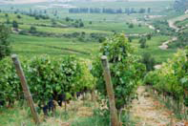
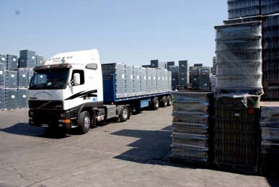
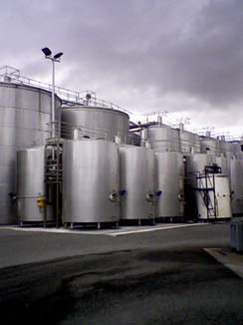
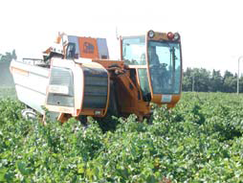
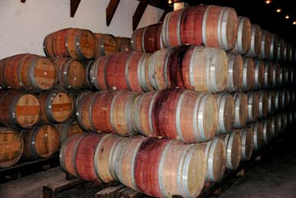
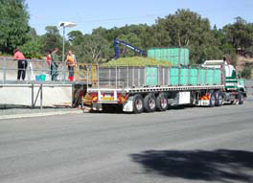
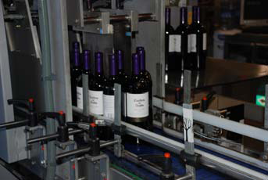
Wine Supply Chain
Delivering
Predicting maturity
Processing
Storing
Harvesting and Transporting
Crushing
Bottling

Slide 15
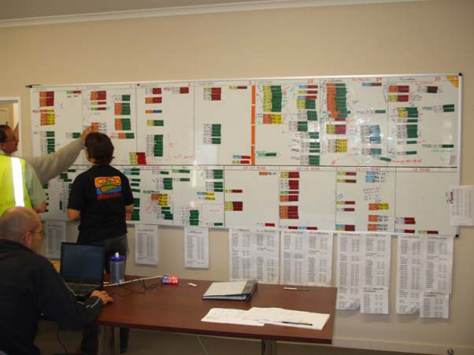
Typical Solution

Slide 16
A thought from the past
“Problems require holistic treatment. They cannot be treated effectively by decomposing them analytically into separate problems to which optimal solutions are sought.”
R. Ackoff, The Future of OR is Past, JORS, 1979.

Slide 17
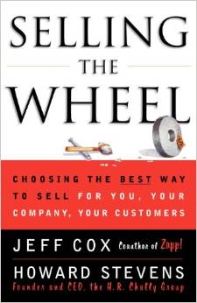
Lessons Learned
Sales is blood of any company
Credibility is the key in
sales activities

Slide 18
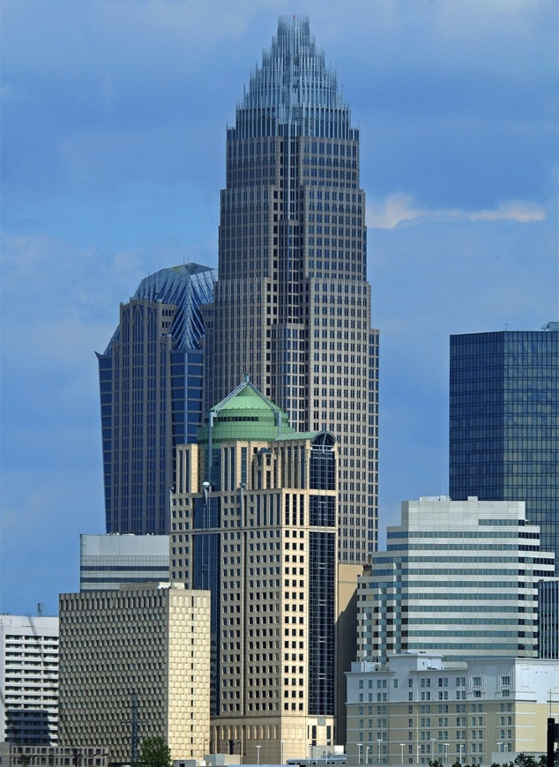
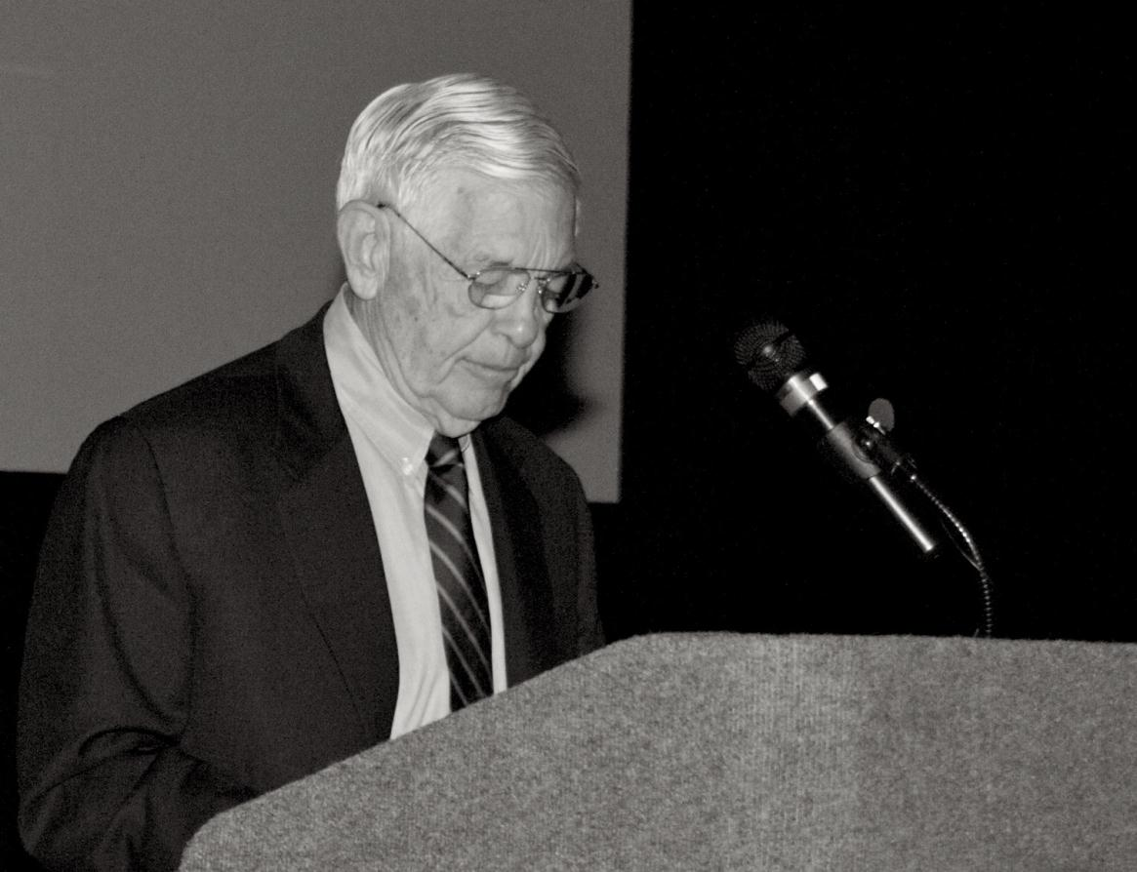
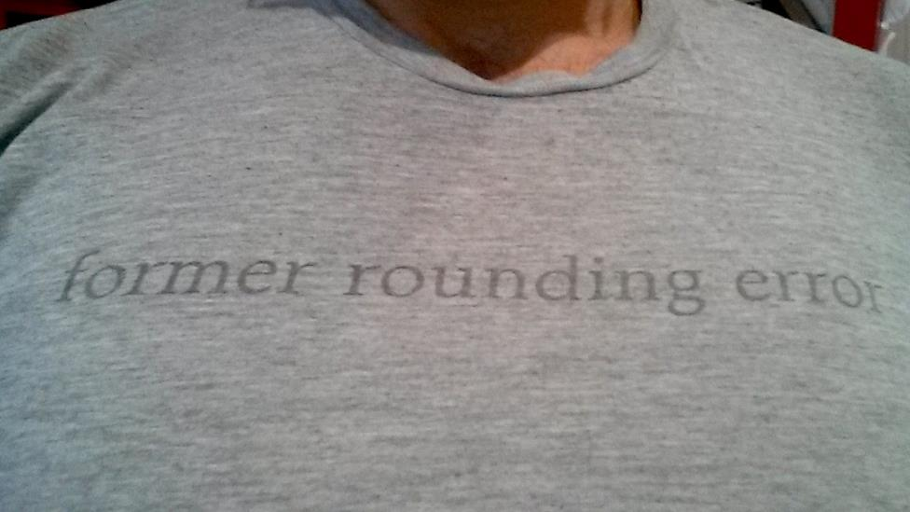
“Credibility” is the Key to Sales
Without credibility, all your sales efforts will fail…

Slide 19
What’s Next?
Incorporated on 30th July, 2014 – one of the most significant dates internationally in past 100 years

Slide 20
“Push” vs “Pull” Start-ups…
Sales
Marketing
Delivery
How most businesses operate…
Technology Product
Customer Service
Innovation
Administration
Notes:
----- Meeting Notes (15/10/13 14:31) -----
EXCERCISE!!!!

Slide 21
Marketing
Market Research
Sales
Customer
Innovation
Delivery
Customer Service

Slide 22
Outline of the Talk
Introductory remarks
SolveIT Software story
Concluding remarks

Slide 23
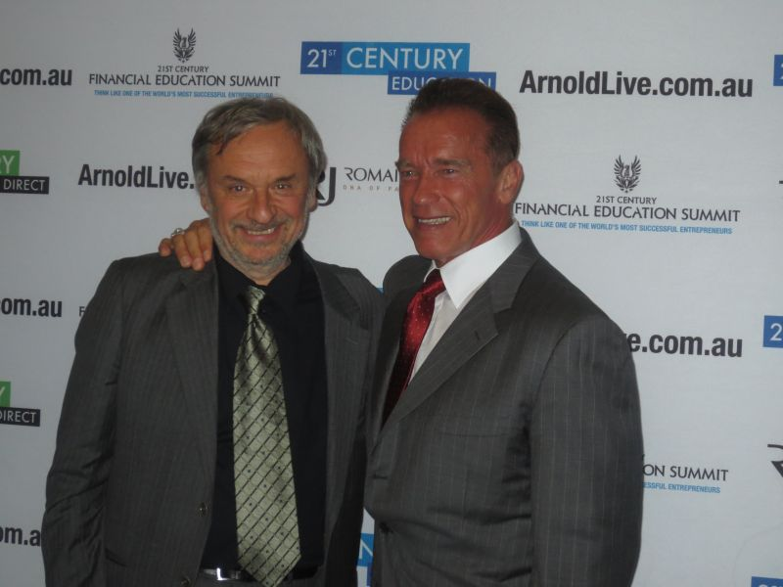

Slide 24
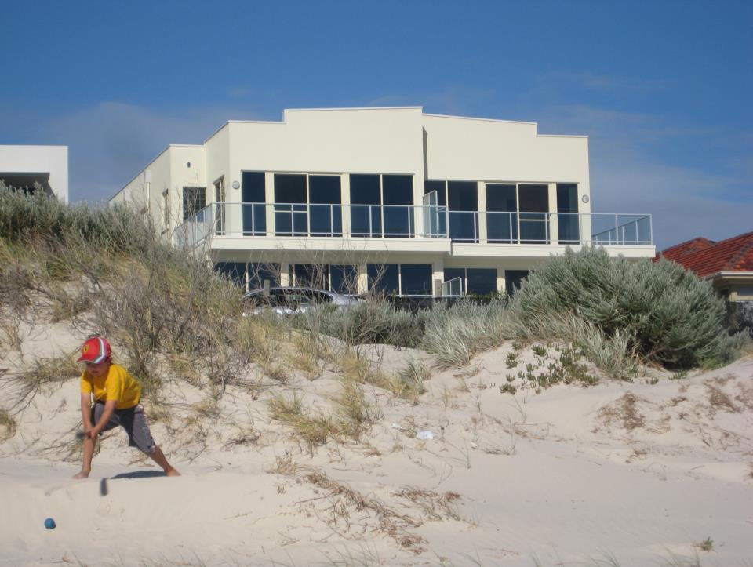

Slide 25
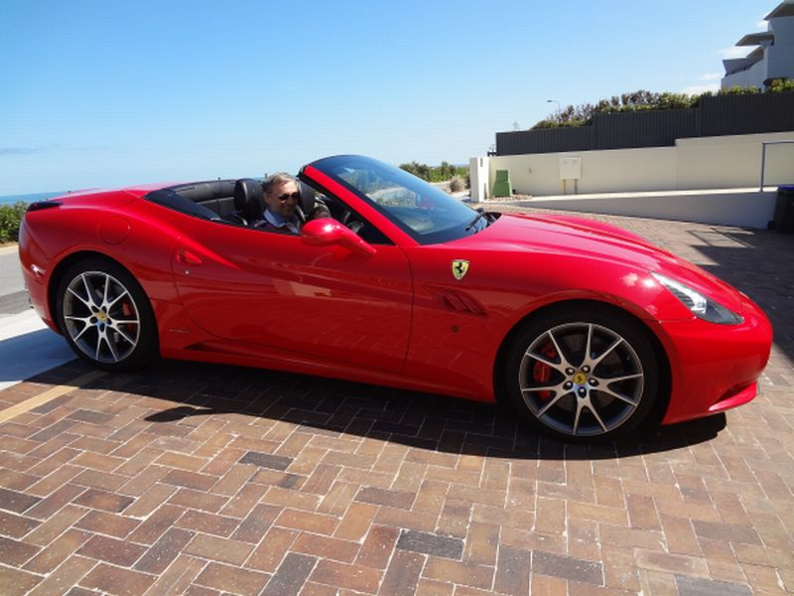

Slide 26
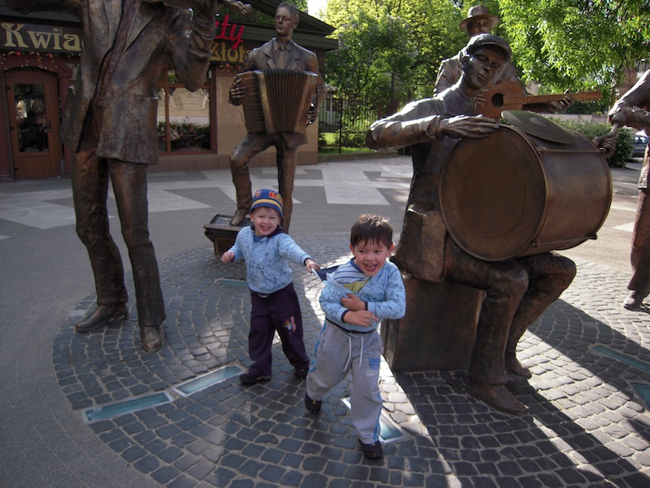

Slide 27
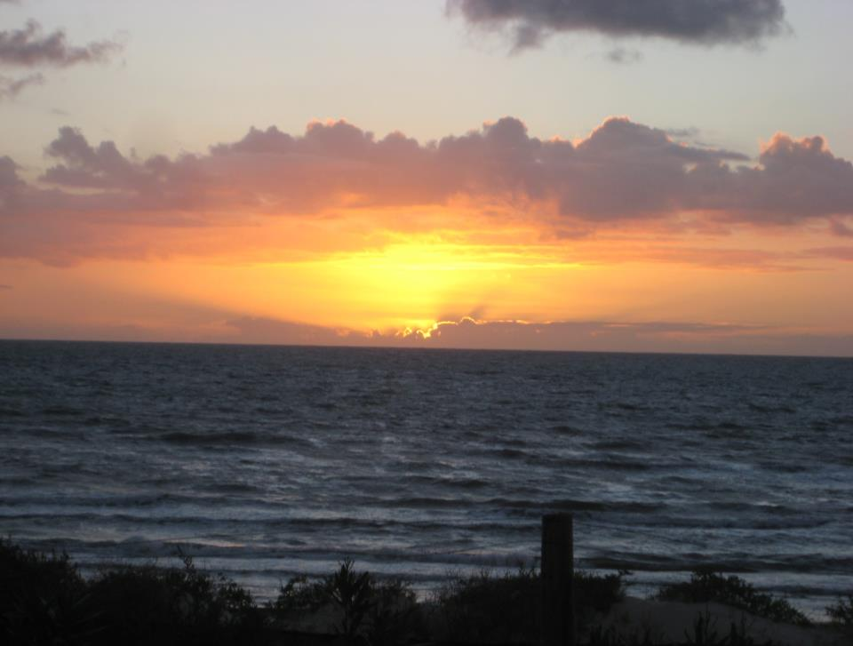

Slide 28
Questions?
Zbigniew Michalewicz
zm@complexica.com

