Slide 1

Some Thoughts on Complexity of Real-World Problems — Evolutionary Computation for Real World Applications
Zbigniew Michalewicz

Slide 2
Outline of the talk
A few remarks
From academia to industry: 1998 – 2014
Complexity of real-world problems

Slide 3
A few remarks

Slide 4
Writing papers
“Look at the last section [of some paper], where there were always some ‘open problems.’ Pick one, and work on it, until you are able to make a little progress. Then write a paper of your own about your progress, and don’t forget to include an ‘open problems’ section, where you put in everything you were unable to do.”
Jeff Ullman, 2009

Slide 5
Writing papers
“Unfortunately this approach, still widely practiced today, encourages mediocrity. […] It almost guarantees that after a while, the work is driven by what can be solved, rather than what needs to be solved.”
“People write papers, and the papers get accepted because they are reviewed by the people who wrote the papers being improved incrementally, but the influence beyond the world of paper-writing is minimal.”
Jeff Ullman, 2009

Slide 6
Question
“Do you want to spend the rest of your life selling sugared water or do you want a chance to change the world?”
Steve Jobs, 1984

Slide 7
From academia to industry: 1998 - 2014

Slide 8
Early 1998
10th year at the University of North Carolina at Charlotte, USA; reflecting on 1997:
Baeck, T., Fogel, D., and Michalewicz, Z. (Editors), Handbook of Evolutionary Computation, joint publication of Oxford University Press and IOP
Two additional edited books: Evolutionary Algorithms in Engineering Applications, Springer, and Evolutionary Computation, IOS Press
Translations of Genetic Algorithms + Data Structures = Evolution Programs, (3rd edition, Springer, 1996) into Polish, Korean, Chinese
Program Chair of the 4th IEEE International Conference on Evolutionary Computation, Indianapolis, April 13 – 16, 1997
National Science Foundations grant on genetic algorithms and constraints
Executive vice-president of the IEEE Neural Network Society
13 book chapters, 7 journal articles (including paper in the no.1, vol.1 issue of the IEEE Transactions on Evolutionary Computation), 17 papers in proceedings of int. conferences, plenary talks
Promotion to Full Professor…
…but somehow I felt that I was selling sugared water…☹

Slide 9


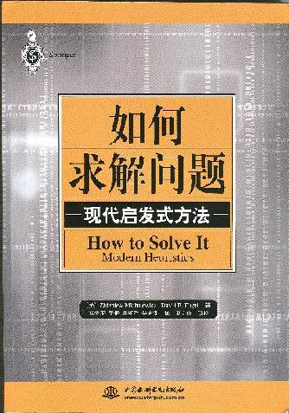

Aarhus University, Denmark, 1998/99
Work on How to Solve It: Modern Heuristics

Slide 10
Focus on real-world problems
In How to Solve It: Modern Heuristics the focus was on real-world problems; they might be difficult to solve due to many reasons:
The number of possible solutions
Many conflicting objectives
Dynamic environment
Many constraints of different types
Other issues (e.g. uncertainty of some information, robustness of a solution).

Slide 11
NuTech Solutions
Incorporation of NuTech Solutions (Charlotte, North Carolina), December 1999.
Departure from NuTech Solutions, September 2003. (Later NuTech was bought by Netezza Corp. which was bought 3 years ago by IBM).
Thinking, what to do next? Travelling…
Decision on moving to Australia…☺
(Founders of SolveIT arrived in Adelaide
separately, from April 2004 to December 2004)…

Slide 12
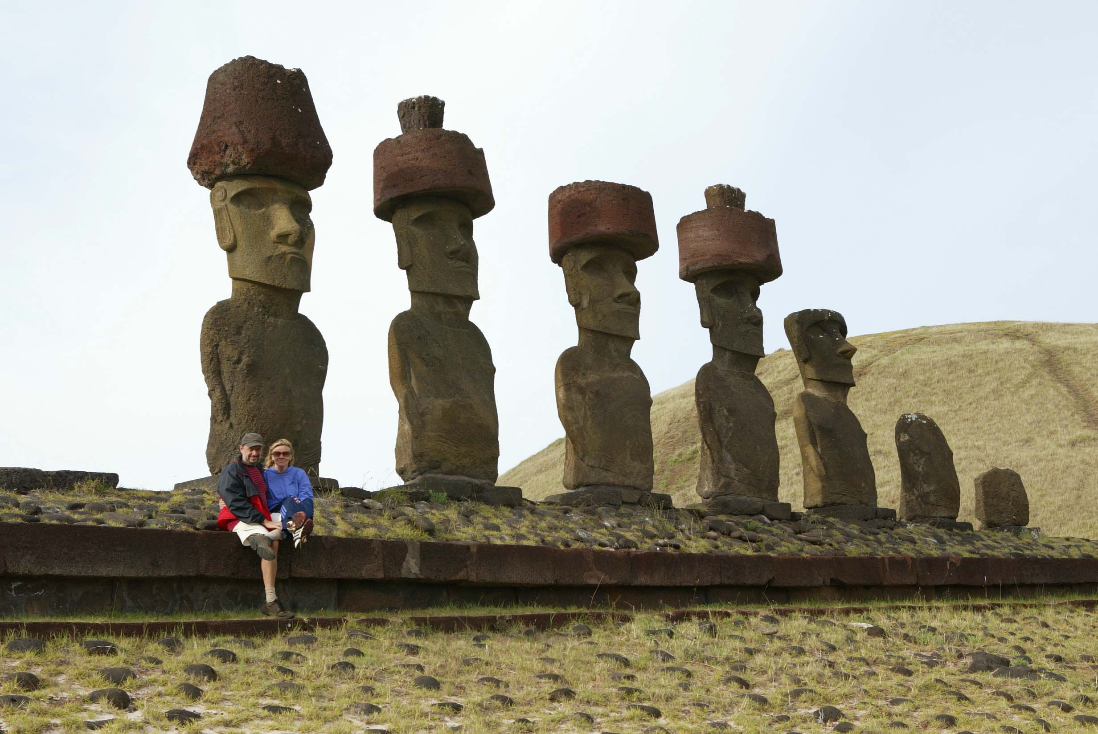
Easter Island, November 2003
Outline of the talk
A few introductory remarks
Some thoughts on modern (integrated) Decision Support Systems (iDDS)
A quick look at an EA-based iDSS
Conclusions

Slide 13
Fact
November 2003, Easter Island…
… I was kidnapped over by locals there and the ransom was set for $20 …

Slide 14



2004/05
Arrival at University of Adelaide: November 2004
Incorporation of SolveIT Software: February 2005
Working on 3 books:
Three basic (interacting) components:
  Prediction
  Optimisation
  Adaptation

Slide 15
Early projects 2005 – 2009
In many projects at NuTech and early projects at SolveIT we focused on a well-defined problems (car distribution, trades, schedules, advertisement plans) – and in all developed systems there were three major ingredients of intelligence:
  Ability to predict
  Ability to optimise
  Ability to adapt

Slide 16
Later projects 2010 – 2012
All earlier projects (from today’s perspective) I would call a single silo problems.
From 2010 we were challenged by different types of problems (multi-silo problems)…

Slide 17
One example
Consider decision support system for delivery of water tanks to farmers in Australia. Delivery decisions (many customers/orders & dealers, due dates, etc.); include:
  selection of trucks / trailers
  selection of drivers
  packing (including bundling)
  possible pick-ups from dealers on the way
  routing (including dealers and unbundling sites)
  etc.

Slide 18
One example
Each of these problems is hard to solve on its own.
For example, the problem of packing of goods on trucks and trailers cannot be solved with standard 2D or 3D packing algorithms, as different types of tanks can be packed in different ways, e.g. bundled inside each other, on top of each other, taking into account various constraints, in a pyramid stacking configuration, or as loose items.

Slide 19
One example
Further, many of these problems are connected in the sense that decisions made in one problem may impact some decisions for another problem:
The packing and routing problems are intertwined, as the destination locations of items packed on a truck/trailer for a trip determine the final delivery destinations to be visited.
Bundled water tanks can be unbundled only at specific agent locations, which has to be done prior to final delivery to customer locations.
A decision of using a particular truck with a trailer for a trip may prevent another delivery which requires a driver with appropriate qualifications.

Slide 20
Global vs. silo optimisation
The optimal decision in one problem may prevent finding the overall optimal solution...
A thought from the past:
“Problems require holistic treatment. They cannot be treated effectively by decomposing them analytically into separate problems to which optimal solutions are sought.”
R. Ackoff, The Future of OR is Past, JORS, 1979.

Slide 21
Global vs. silo optimisation
Research on “silo” problems (e.g. job shop scheduling, TSP, knapsack, vehicle routing) is of decreasing significance today.
The current challenge is to address integrated problems with all of their complexities.
What should I do?

Slide 22
Structure of a real-world problem

Slide 23
Complexity of real-world problems

Slide 24
A quiz
Classify all positive real numbers into some categories based on the magnitude of a number…
Numbers larger than 0, but not larger than 10.
Numbers larger than 10, but not larger than 25.
Numbers larger than 25, but not larger than 40.
Numbers larger than 40, but not larger than 60.
Numbers larger than 60, but not larger than 100.
Numbers larger than 100.

Slide 25
A quiz
Classify all positive real numbers into some categories based on the magnitude of a number…
Numbers larger than 0, but not larger than 10.
Numbers larger than 10, but not larger than 25.
Numbers larger than 25, but not larger than 40.
Numbers larger than 40, but not larger than 60.
Numbers larger than 60, but not larger than 100.
Numbers larger than 100.

Slide 26
Analysis of algorithms
Classify all problems into some categories based on time-complexity of the required algorithm…
  Binary search O(log(n))
  Sequential search O(n)
  Sorting O(n log(n))
  Topological sort O(n²)
  Matrix multiplication O(n^{log}2⁷)
  NP-hard problems…

Slide 27
Analysis of algorithms
Classify all problems into some categories based on time-complexity of the required algorithm…
  Binary search O(log(n))
  Sequential search O(n)
  Sorting O(n log(n))
  Topological sort O(n²)
  Matrix multiplication O(n^{log}2⁷)
  NP-hard problems…

Slide 28
A quote
Novel In Desert and Wilderness by H. Sienkiewicz, first published in 1912
– “How many are there?”
Kali moved the fingers of both hands and the toes of both his feet about a score of times, but it was evident that he could not indicate the exact number for a simple reason that he could not count above ten and every greater amount appeared to him as wengi, that is, multitude.

Slide 29
Comparison
Academic problems vs. real-world problems
The concept of NP-hardness hardly applies in real world (e.g. it is unusual for a company to grow from 1,000 trucks to 10,000 trucks, and 100,000 trucks)…
The complexity of real-world problems emerges from interactions among sub-problems rather than size of a problem…

Slide 30
Research problems
Over the last 30 years experimental research concentrated on well-defined NP-hard “silo” problems:
Travelling salesman problems
Knapsack problems
Graph colouring problems
Vehicle routing problems
Allocation problems
Network flow problems
Job-shop scheduling problems
etc.

Slide 31
Research problems
Over the last 30 years experimental research concentrated on well-defined NP-hard “silo” problems:
Travelling salesman problems
Knapsack problems
Graph colouring problems
Vehicle routing problems
Allocation problems
Network flow problems
Job-shop scheduling problems
etc.

Slide 32
Travelling salesman problem
Given a list of cities and all costs of moving between them, find a cycle that visits each city precisely once and minimizes the total cost…

Slide 33
Travelling salesman problem
Given a list of cities and all costs of moving between them, find a cycle that visits each city precisely once and minimizes the total cost…
a possible
solution

Slide 34
Travelling salesman problem
Given a list of cities and all costs of moving between them, find a cycle that visits each city precisely once and minimizes the total cost…
Thousands of research papers
Many books
Hundreds of algorithms
Very active research area…

Slide 35
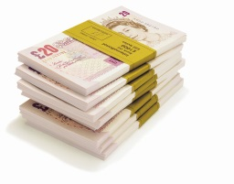



Knapsack problem
Given a list of items, each with a value V and a weight W, select a number of items to maximize the total value but not exceed the threshold weight (capacity).
V: 7 9 11 16 34 21 14 18 25
W: 3 4 5 7 19 10 8 9 12
Say, capacity of knapsack is 40…

Slide 36
Knapsack problem
Given a list of items, each with a value V and a weight W, select a number of items to maximize the total value but not exceed the threshold weight (capacity).
a possible solution
V: 7 9 11 16 34 21 14 18 25
W: 3 4 5 7 19 10 8 9 12
Say, capacity of knapsack is 40…

Slide 37
Knapsack problem
Given a list of items, each with a value V and a weight W, select a number of items to maximize the total value but not exceed the threshold weight (capacity).
Again:
Thousands of research papers
Many books
Hundreds of algorithms
Very active research area…

Slide 38
Travelling thief problem
Given a list of cities and items available in these cities, find a cycle that visits each city precisely once, collect some items available in these cities, to (1) minimize the total cost of the travel, and (2) maximize the value. Note, that the cost of travel is a function of the current load…
B, H
A, F, G
P, Q, R
A, F, G
K
G, S
M, N
D, F
J, S, T
A, B

Slide 39
Travelling thief problem
Given a list of cities and items available in these cities, find a cycle that visits each city precisely once, collect some items available in these cities, to (1) minimize the total cost of the travel, and (2) maximize the value. Note, that the cost of travel is a function of the current load…
B, H
A, F, G
P, Q, R
a possible solution (with an indication where to start and what to take – if anything –from each location).
A, F, G
K
G, S
M, N
D, F
J, S, T
A, B

Slide 40
Travelling thief problem
Given a list of cities and items available in these cities, find a cycle that visits each city precisely once, collect some items available in these cities, to (1) minimize the total cost of the travel, and (2) maximize the value. Note, that the cost of travel is a function of the current load…
B, H
No research papers
No books
No known algorithms
No active research…
A, F, G
P, Q, R
A, F, G
K
G, S
M, N
D, F
J, S, T
A, B

Slide 41
Travelling thief problem: different models
There is infinite number of possible interactions between TSP and KP…
TSP
KP
Bonyadi, M.R., Michalewicz, Z. and Barone, L., Travelling Thief Problem: the first step in transition from theoretical problems to realistic problems, Proceedings of the 2013 IEEE Congress on Evolutionary Computation, Cancun, Mexico, June 20 – 23, 2013.

Slide 42
Travelling thief problem: Model 1
One possibility:
maximize G(x, z) = g(z) – R*f(x, z)
  where z is the picking plan, x is the tour, f is the time needed for the travel, R is the rent rate of the knapsack, g is the total value of the picked items
If thief takes more items:
    Gross profit increases (g)
    Travel time increases (f)

Slide 43
Example
tour is the optimal in isolation and picking plan is not optimal
tour is not optimal and picking plan is optimal
tour and picking plan are optimal
neither tour nor picking plan are optimal

Slide 44
Travelling thief problem: Model 2
Another possibility: The value of the picked items drops by time
Objective: G(x, z) = {min f(x, z); max g(x, z)}
    where z is the picking plan, x is the tour, f is the time
    needed for the travel, g is the total value of the picked items
If thief takes more items
  Gross profit increases (g)
  Travel time increases (f)

Slide 45
Example
tour is the optimal in isolation and picking plan is not optimal
tour is not optimal and picking plan is optimal
tour and picking plan are optimal
both tour and picking plan are not optimal
Optimal solutions:
  G1: x = {1, 2, 4, 3}, z = {0, 3, 3, 0, 0}
  G2: x = {1, 2, 4, 3}, z = {0, 3, 0, 0, 0}
  G3: x = {1, 2, 3, 4}, z = {0, 0, 0, 0, 0}

Slide 46
Linear/Integer programming approach
2011 Report “Optimisation in a Coal Export Supply Chain”:
Mixed integer programming can be used to successfully optimize maintenance schedules of critical infrastructure:
  Size of network: 37 nodes, 69 arcs
  Number of maintenance jobs: 1,296 (197 fixed)
  Duration 90 mins – 28 days, average 18 hours
  Number of start times 17-31, average 30.5
  | T | used = 8,254 (time horizon)
  Number of variables: 862,000/496,000
  About 25% of variables are binary
  Number of constraints: 1.6 million/344,000
  MIP solved with Gurobi3.0, single thread Dell PowerEdge2950, 3.16 GHz, 64Gb RAM
  Time to solve: 18 hours per objective

Slide 47
“Evolutionary” algorithms
population of ‘agents’
process of improvements
P
dealing with “what-if” scenarios
handling multi-objective problems (trade-off analysis)
dealing with a variety of constraints
dealing with variability

Slide 48
Co-evolutionary algorithms
Agent #1
Agent #2
Agent #3
cooperative co-evolution

Slide 49
Advantages of “agent-based non-linear cooperative co-evolutionary systems”
dealing with each silo separately
“negotiating” the best overall solution
dealing with “what-if” scenarios
handling non-linear relationships between silos
handling multi-objective problems (trade-off analysis)
dealing with a variety of constraints
dealing with variability

Slide 50
Integrated Decision Support Systems
Decision-support systems that are capable to optimise integrated multi-component operational problems are of great importance for any organisation:
they provide global quality solutions;
they support “what-if analysis” for operational and strategic decisions as well as “trade-off analysis” to handle many objectives.
If the right approach is used, such systems would be also
capable of handling and analysing variability;
easy to use (modifications of constraints/business rules, nonlinear dependencies, explanations of some decisions).

Slide 51
Research Plan
What would happen?
E.g. agent-based non-linear cooperative co-evolutionary system
Approach
A problem
How to measure its complexity?
How to classify problems on their complexity?

Slide 52
Science issues
Global optimisation in the integrated view
Constraint handling issues (within silos, interactions between silos)
Flexibility of the model; what-if scenarios
Variability & robustness
Multi-objective optimisation and trade-offs against KPIs
Handling different time horizons
Explanatory features of the optimiser
Running time of the algorithm

Slide 53
Rewards
And if you address important (for the real-world) issues, there are some great academic rewards as well:
You would be cited extensively…
Your h-index would go up to some high levels…
You would get a nice recognition within your research community…
You will be getting more invitations (e.g. keynote talks) than you can handle…
and your personal life would change forever…☺

Slide 54
Thank you…☺

Slide 55

Thank you…☺

