Slide 1
From Anger to Acceptance: AI in AUT Business School
Dr Geri Harris
Senior Lecturer, AUT Business School
Co-Authors:
Dr Jeremy Morrow, Chris Griffiths, Prabhash Parameswaran, Michelle Williams

Slide 2
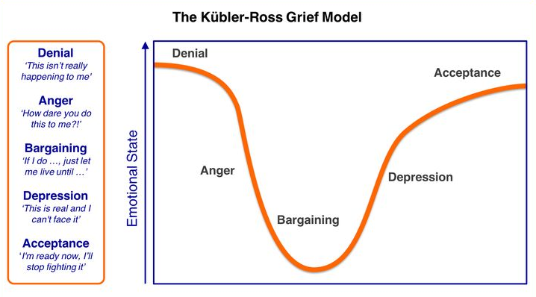
In Education
This is bad news!
Move on, explore way forward
We must ban gen-AI!
Realisation of the inevitable
Catch the cheaters!
Adapted from: Kübler-Ross, E. (1970). On death and dying. Collier Books/Macmillan Publishing Co.

Slide 3
AI for Learning

Slide 4
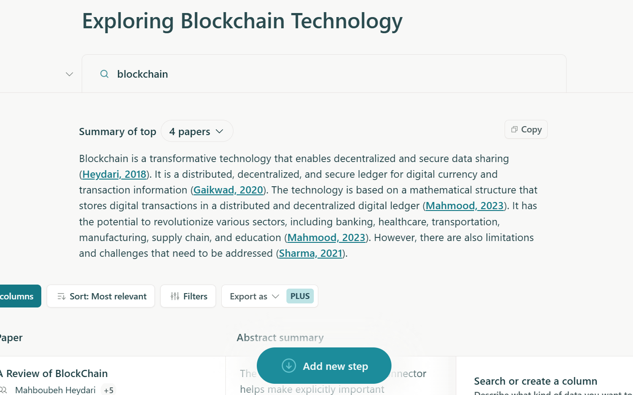
AI assisted learning: Grasp main points
"If a workman wishes to do a good job, he must first sharpen his tools", and AI is that tool for my effective learning”
Elicit; Perplexity
Quickly extract key information
DOI link can access the paper
Number of citations help gauge the quality of the paper

Slide 5
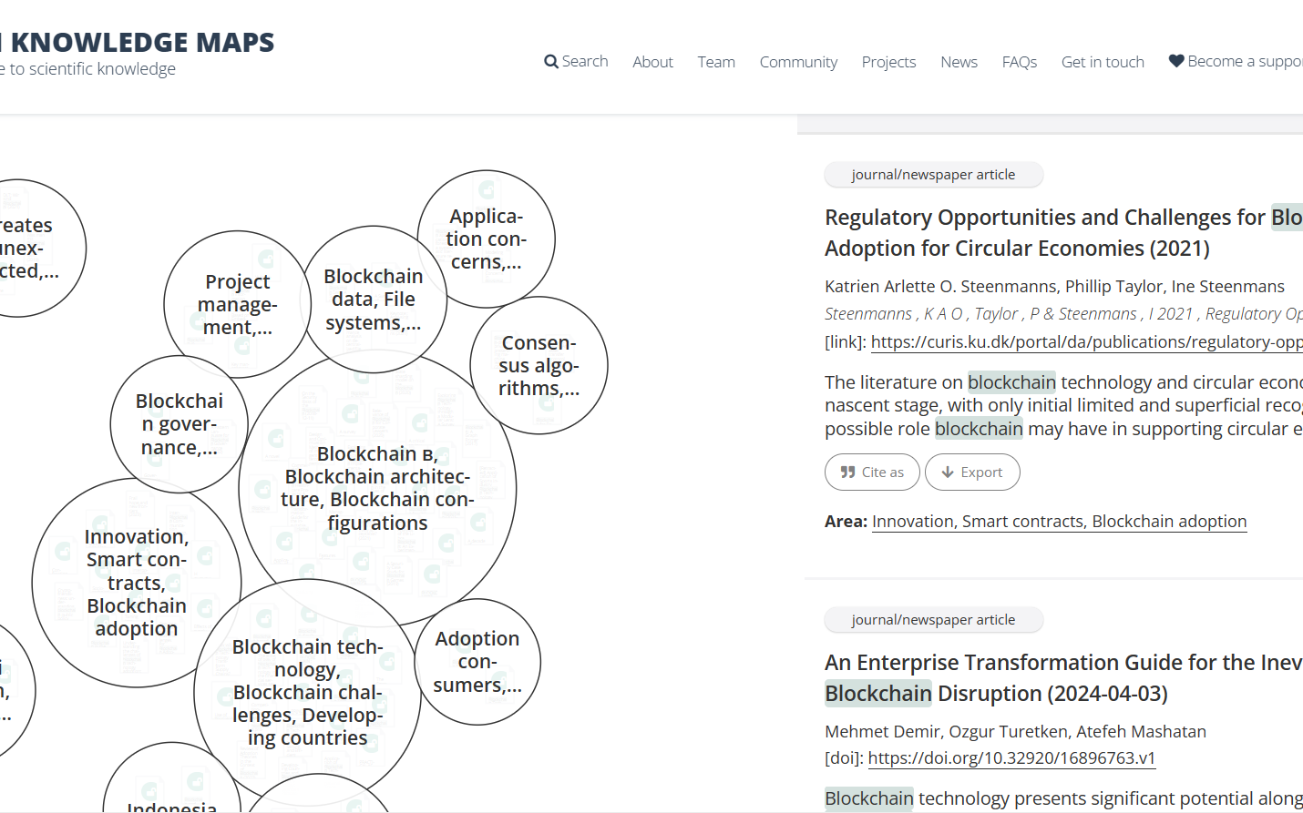
Research companion: retrieve and connect
Boost research efficiency
Key Feature
Literature Abstracts and links
Sub-theme
Openknowledgemaps.org

Slide 6
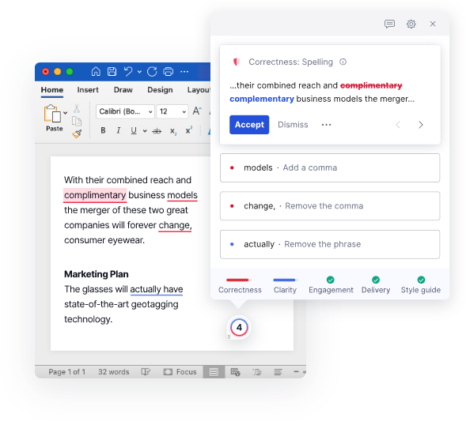
Overcome language barriers
Grammarly
Fix spelling & grammar
Supports multiple languages
Rewrite suggestions

Slide 7
Support for learning challenges
“People with disabilities are already challenged”
Noodle Factory
Feedback helps improve my work
24/7 tutor available to help clarify content for me
Chat GPT
My written work can be simplified to be concise
Can clarify complex text for easier understanding
To some degree, can act as a personal tutor in discussion and debate
“I believe that AI can help make the complicated simple for everyone, not just me as a dyslexic” STUART

Slide 8
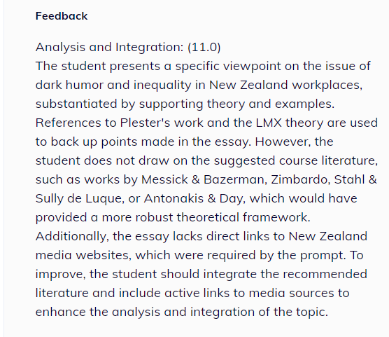
Input Draft Blog Assessment into Noodle Factory - AI feedback
“The feedback provided states what is lacking in the required tasks and allows me to know exactly what I need to work on”
DISCLAIMER

Slide 9
Innovative learning practices: Digital Marketing
Harnessing AI to build interactive personas
Persona personalities backed by student-led research using data on market trends
Guided play experiments
Training students in AI literacy

Slide 10
AI for Teaching

Slide 11
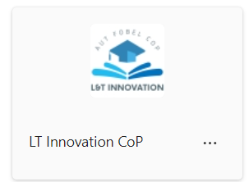
Upskilling Business School staff
AI Literacy training - MANDATORY
AUT community of practice
AUT Generative AI Insights Teams channel
FOBEL Learning and Teaching awareness sessions
Demystifying sessions
Techweek 2024 panel discussion
Supportive culture to experiment, share resources, lessons

Slide 12
Engage students: Curipod “lesson curation”
Students access poll using a QR code
Static content
Lecturer displays a poll

Slide 13
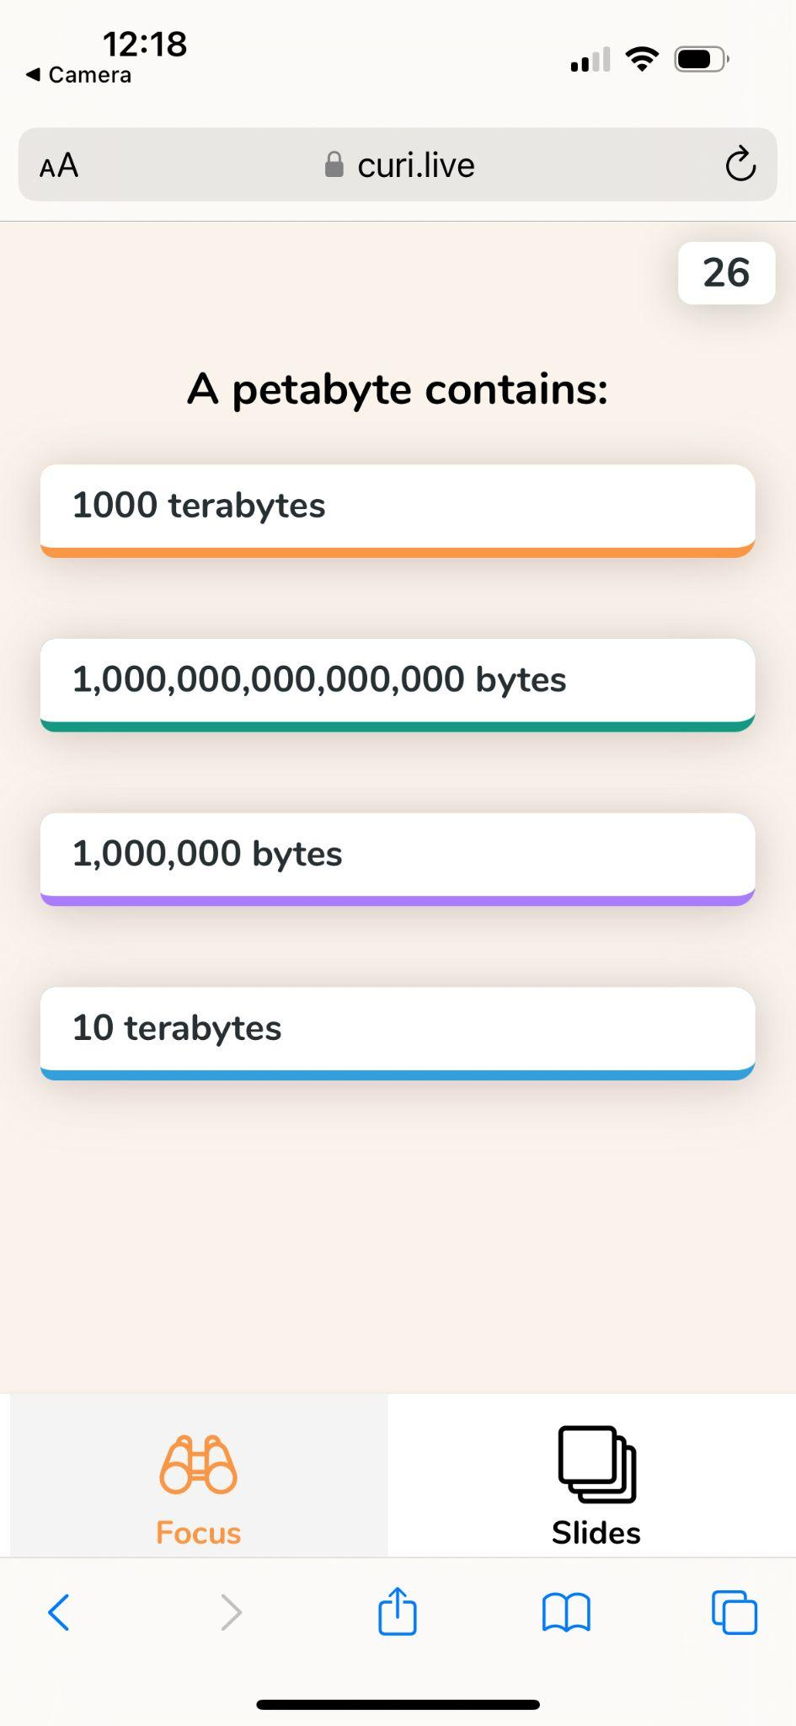
Focus on a key learning: the sheer volume of data we capture

Slide 14
More Interaction: AI quizzes and formative assessments

Slide 15
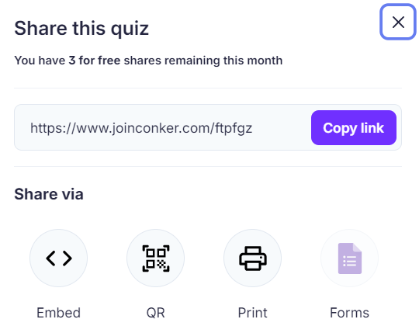
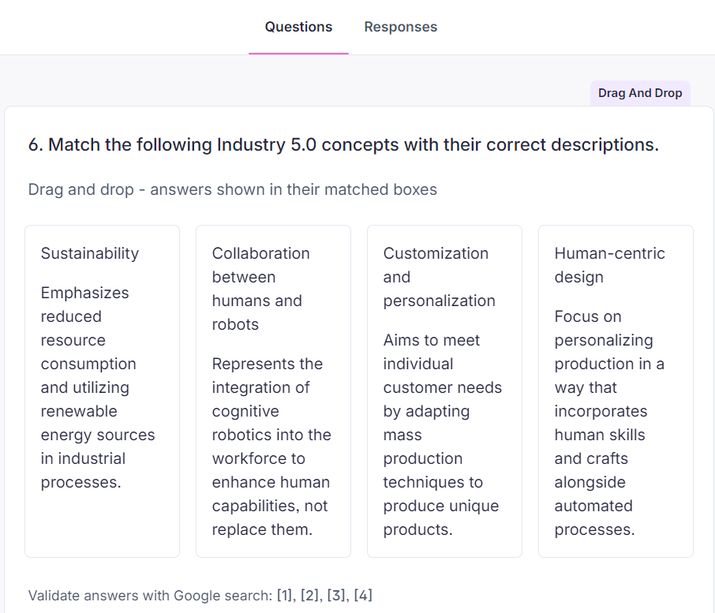
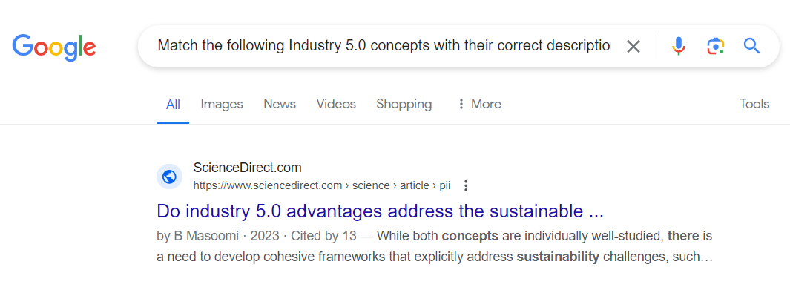
You can verify the question accuracy

Slide 16
AI in Assessments

Slide 17
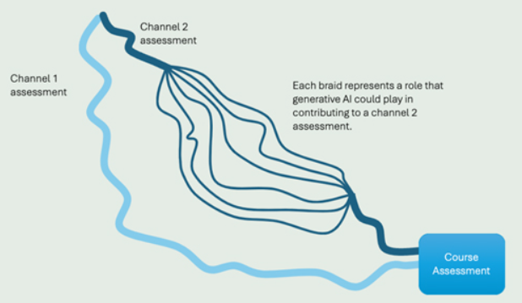
Lots done, more to do…
2 ‘channels’
6 ‘braids’
Updated Assessment Policy for Faculty of Business, Economics & Law
AUT library resources for ethical & responsible AI use
Guidelines for AI in Assessments based on the “2-lane” approach

Slide 18
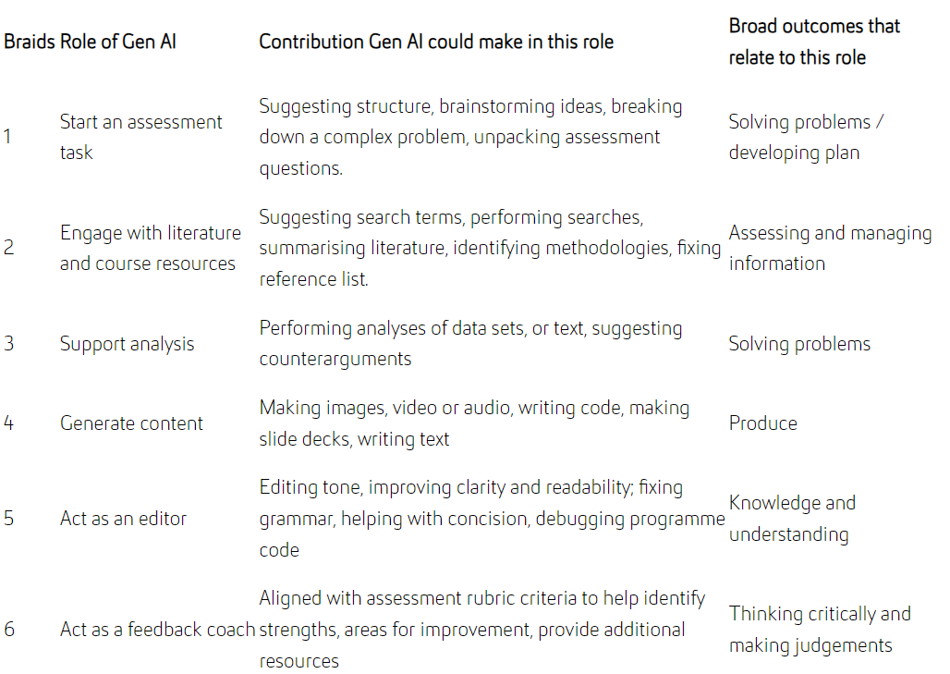

Slide 19
Interactive Oral Assessment
BSYS842 – Digital Technologies
An authentic experiential assessment??
Assessment 2 – Case Study
Previous iterations had ‘problematic’ written submissions
Brief, unscripted one-on-one conversation simulating real-world scenarios.
Examiner uses pre-defined prompts, focusing on learning outcomes.
Student applies knowledge and skills to solve an authentic problem, responding to the further prompts and questions.
BUT… time consuming? Practical?

Slide 20
How do we test students in Gen-AI age?
BSYS603 – Project Management
Assessments 2 and 3
Assessment 1 – open-book quiz
Divided screens: Canvas & ChatGPT!
Why? Wanted to validate my answers. Meant I didn’t need to study. Figured it would give the right answer.
Average mark 64%
1 student scored 53%; I watched her copy & paste into Chat GPT
Prescribe AI agents must be used
Educate need for critical evaluation of AI output
Reward ethical & responsible use in Rubric
Teach students AI literacy skills
Overcome Copilot access issues
Scaffold the Assessment tasks through weekly in-class activities
Redesigning Assessment 3 (Case Study) with LTED
Authenticity, integrity, workplace readiness

Slide 21
AI for Research

Slide 22
Workshop: “Streamline Your Research Processes With AI Tools”
Researcher Education and Development (RED) team

Slide 23
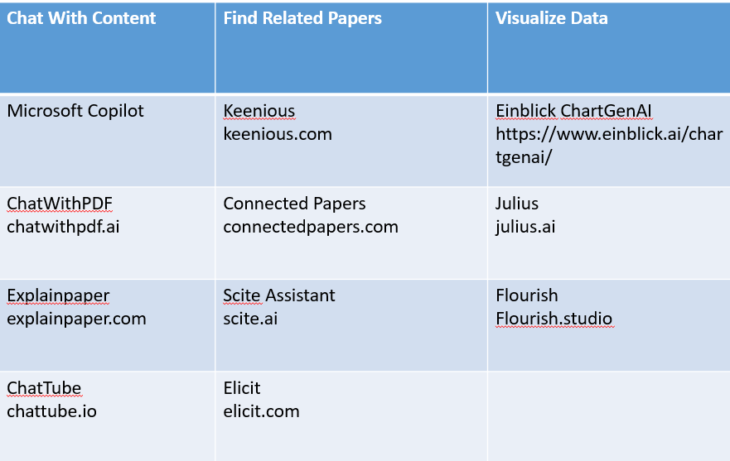
AUT-recommended: AI Tools for Chatting with Text

Slide 24
AI in Research: Lessons from early adopters
Can be a short task to fit into a busy schedule
Take less time to determine if an article is worth reading in full
Get information not clear in the abstract
Get page citations for the answers
Inquire about methodologies, participants, study design, relevance to other disciplines, how the results can be applied to your own research…and more

Slide 25
EmbedRED: Training in AI for AUT researchers
New AI Guidelines for AUT PG Researchers
Guidelines for Use of AI Tools to Support Your Research
Examples of Using AI Tools Ethically
Being Informed and Transparent About Your Use of AI Tools
Examples of AI Use That Compromise Academic Integrity

Slide 26
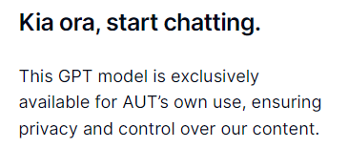
Addressing privacy: AUT-specific AI agents
AUT Co-Pilot
AUT GPT
Cogniti trial
ICT recommends the use of Copilot in Edge for staff AND students
LMS integration (agents can be embedded as a plugin)​.
Conversations are logged and available to educators and administrators, increasing safety for students​​.

Slide 27
Resistance to change: bring colleagues on the journey
Writing with AI is not plagiarism…but it’s also not original authorship
Student disclosure of AI use in assessments
Change how learning outcomes are demonstrated
Redesign assessments - within university policies
Interactive Oral Assessments
Gamification
ChatBot / local LLM specific to courses
Teach AI literacy to students
Educate about ethical and responsible use of tools
Structured prompts for written assessments

Slide 28
Where are you on the curve?

Slide 29
Please download and install the Slido app on all computers you use
Anger or Acceptance?
ⓘ Start presenting to display the poll results on this slide.

Slide 30
My view on AI in education
“Empower students and educators; be open to learning; be curious; and shape students for the workplace”
geri.harris@aut.ac.nz

Slide 31
AI Blueprint for Aotearoa – July 2024
Outlines a strategic vision for integrating AI into New Zealand’s education sector
Aims to prepare students and educators for a future where AI plays a significant role in society and the economy
The result of in-depth consultations and workshops with a wide range of educators and decision-makers

Slide 32
Vision and Goals
Position New Zealand as a global leader in AI education by 2030
Ensure AI integration supports a prosperous, inclusive, and equitable future for all New Zealanders
The future of education in New Zealand is one where learners are equipped, educators are empowered, and our nation excels in educational innovation, harnessing AI capabilities

Slide 33
To succeed within the next 12 months
Establish a national taskforce
Establish a community of practice
Educate the educators
By May 2025 we will have:
Well-defined frameworks and guidelines for AI integration in education, at all levels.
Useful insights and tested AI tools from pilot programmes, to guide future applications.
Significant improvements in AI knowledge amongst both educators and learners.

Slide 34
Call to Action
Action 1
Actively participate in the AI in Education workstream
Contact information for further engagement and collaboration: geri.harris@aut.ac.nz

Slide 35
Community of Practice
Action 2
Work on the action plans in our AI Blueprint for Aotearoa is underway, including partnering with Tim Gander and Brendon Shaw’s AI in Education Community of Practice (CoP) which brings educators together
Meeting fortnightly online
Sharing best practice Learn more

Slide 36
Recent roundtable on ‘educating the educators’
A self-diagnostic tool would help educators to gauge where we are in terms of AI literacy and confidence to use
Coupled with a roadmap suggesting appropriate next steps, a diagnostic could show us what we can do with AI tools that we are not currently doing
If teachers had an official “green light” from MoE and NZQA to experiment with AI tools and techniques, without fear of getting into trouble (privacy, policy, regulations) it would encourage innovation
Perhaps all students should sign a “responsible AI use” form at the start of each academic year (similar to the responsible Internet and social media forms they currently sign)? This would normalise AI tool usage like we did with the Internet
Empower educators to make real changes in assessments that are not caught up in bureaucracy to implement
Provide a centralised repository of tried and tested AI tools for use in teaching & learning
Expand the AI Community of Practice to become a regional network of experts to support educators through technical advice and professional development sessions
Establish clusters of schools / higher educators to collaborate and share learning experiences
Roll out training in AI literacy to all educators
Compile a list of training resources currently available for AI in education and make these available
Action 3

